Slide 1
Global Precipitation Measurement (GPM) Mission
Dr. Dalia Kirschbaum
GPM Applications Scientist and Education Coordinator
Goddard Space Flight Center
June 26th, 2013
Notes:
Introduce ourselves

Slide 2
Guiding Questions
Why do we need to measure rain and snow globally?
What do we have now?
What is the Global Precipitation Measurement (GPM) Mission?
Where and When is all this science and engineering happening?
How can we use the data?
Resources available to you!
Educational Themes
Notes:
Gail

Slide 3
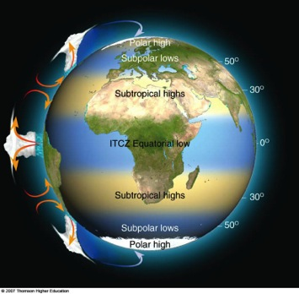
Why measure GLOBAL precipitation (rain, snow, ice)?
Precipitation is felt
locally, but interacts with large-scale circulation patterns. Precipitation links the Earth’s ENERGY and WATER cycles.
70% of the earth is covered by water where radar and gauges are very sparse. Even the coverage of gauges on land is quite small!
Space-borne remote sensing can provide both the space and time coverage needed for measuring and evaluating precipitation across the globe, particularly in areas without ground-based instruments (e.g. rain gauges, radar).
Notes:
Gail

Slide 4
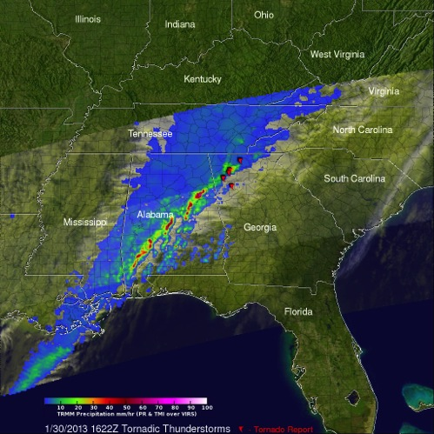
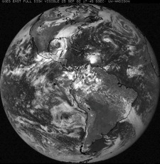
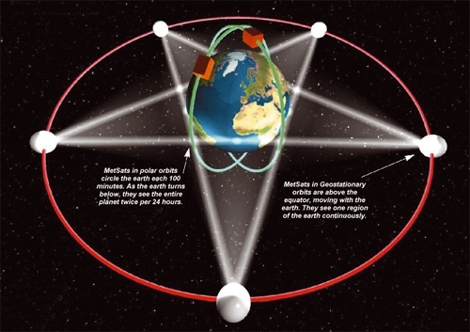
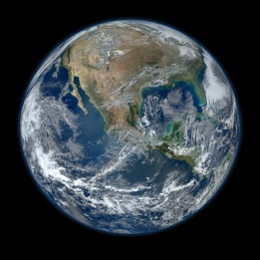
What do we have now?
Traditional infrared weather satellites orbit the Earth ~20,000 miles above the surface, providing a continuous picture of one slice of the earth
Polar orbiting satellites cross at the same time of day
Non-sun-synchronous satellites can view the earth at the same point at different times of a day
GOES Image
(Geostationary
orbit)
Suomi NPP composite image
(Polar orbit)
TRMM pass over Southeast US
(non-sun-synchronous orbit)
http://www.eohandbook.com/eohb05/ceos/part2_6.html

Slide 5
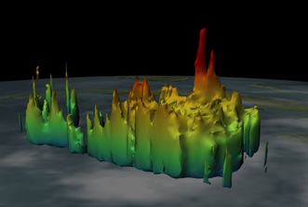
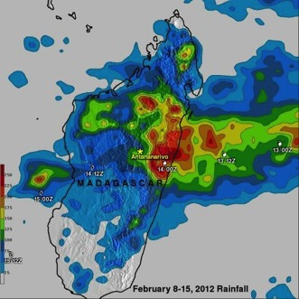
Overview: Tropical Rainfall Measuring Mission
Hot Towers observed in Hurricane Wilma
Launched in 1997 to measure tropical rainfall
Currently has a 15-year record of precipitation from ~35°North to 35°South
Partnership between NASA and the Japan Aerospace Exploration Agency (JAXA)
Data at http://trmm.gsfc.nasa.gov
We need better instruments and improved models to identify light rainfall and snow in higher latitudes
Rainfall Accumulation from Tropical Cyclone Giovanna, triggering deadly floods in Madagascar
Notes:
Gail

Slide 6
The GPM Core Observatory
The GPM Core Observatory will carry two advanced instruments that allow us to view precipitation (rain, snow, ice) in new ways and serve as a connector between the GPM Core and measurements taken on other partner satellites
Non-Sun-Synchronous orbit at 65º inclination (Arctic to the Antarctic Circle) at 407 km
Dual-frequency Precipitation Radar (DPR): Ku-Ka bands
Two different radar frequencies that can look at precipitation in 3-D throughout the atmospheric column.
GPM Microwave Imager (GMI): 10-183 GHz
13 channels which provide an integrated picture of the energy emitted by precipitation, including light rain to heavy rain to falling snow

Slide 7
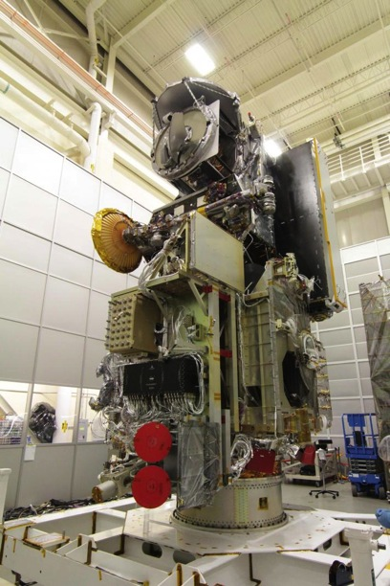
Cool testing at NASA Goddard!
Core Observatory satellite is being built and tested at GSFC.
May 2011 – Centrifuge testing
May 2012 – Completed instrument integration
August 2012 – Solar array vibration and acoustic testing
December 2012 – Thermal Vacuum Testing
March 2013 – Electromagnetic Interference Testing
June 2013 – Solar Array Deployment testing
Early November, 2013 - GPM Core shipped to Tanegashima Island, Japan
February, 2014 – GPM Launch!
GPM at the clean room at NASA GSFC

Slide 8
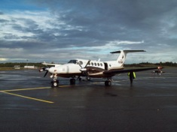
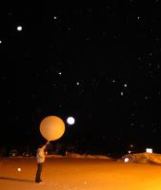
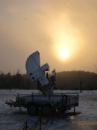
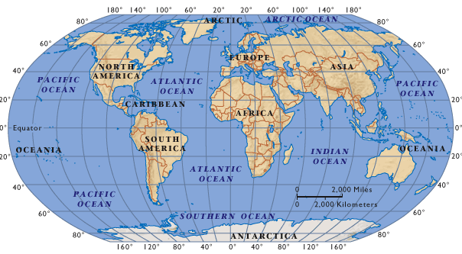
Ground Validation and Field Campaigns
Connecting the dots between what the satellite “sees” from space and what we observe on the ground
Warm rain processes: Brazil (2010)
Light Rain Processes: Finland (2010)
Mid-latitude Continental Convective Storms: Oklahoma (2011)
Falling snow: Canada (2012)
Flooding and hydrologic modeling: Iowa (2013)
There is also a permanent ground validation effort at Wallops Flight Facility, Maryland
NASA-EC GCPEX (2012)
LPVEx (2010)
iFLOODS (2013)
MC3E (2011)
Pre-CHUVA (2010)

Slide 9
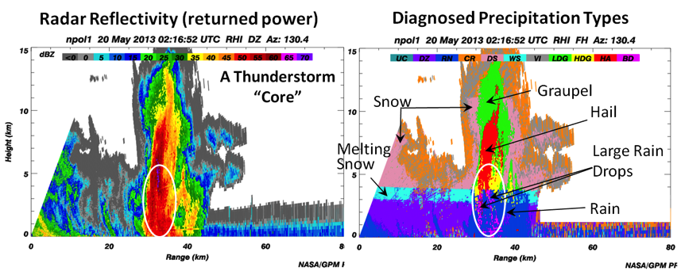
5/20/2013: Defining what satellites are “seeing”
Example from 5/20/2013: Defining what satellites are “seeing”
NPOL –Diagnosed Cross-Sections of the Precipitation Process

Slide 10
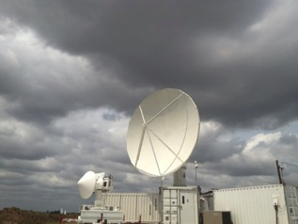
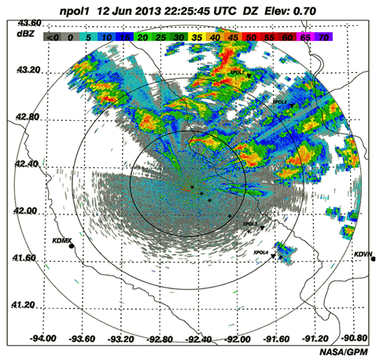
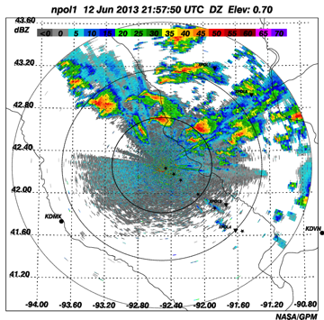
IFloodS: June 12, 2013 Severe Storm Outbreak
On Wednesday afternoon, June 12th there was a severe storm outbreak that developed and moved across central and eastern Iowa, spawning several tornadoes and huge thunderstorms.
The NPOL radar was able to observe a Hook echo in a supercell only 40 km north of the radar. Images show convective Boundary Layer Development over NPOL and D3R on 6/12/2013 at ~1700 UTC. NPOL capturing line of multiple supercells, some tornadic moving across Iowa on June 12th at 21:57 UTC

Slide 11
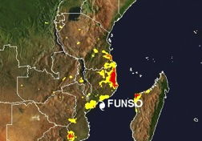
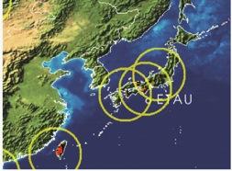
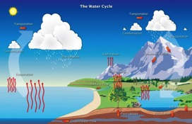
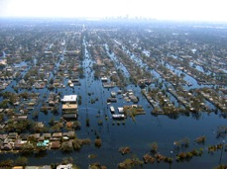
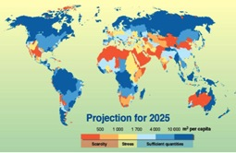
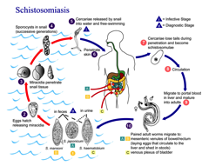
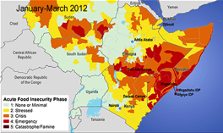
What can we do with the data?
Flooding
Landslides
Land surface and climate modeling
Freshwater Availability
Extreme Events
The rain and snow data gathered from the TRMM and GPM missions already provide and will extend our capabilities to study a wide range of applications for scientific research and societal benefit.
World Health
Agriculture/Famine Early Warning
Notes:
Dalia

Slide 12
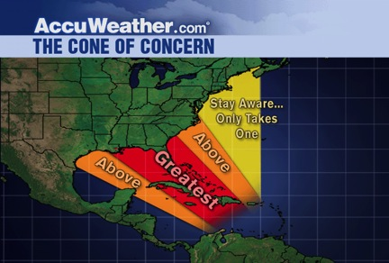
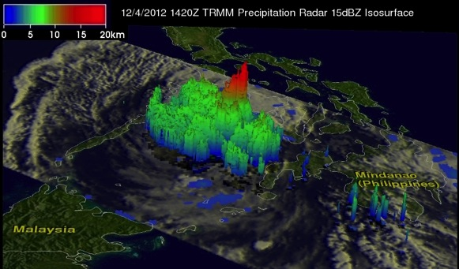
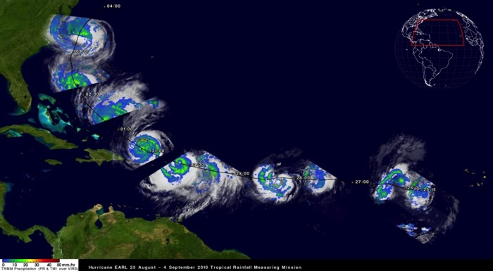
Severe Storms
GPM’s orbit will enable observation of tropical cyclones as they progress from tropical to mid-latitude systems
Typhoon Bopha, Dec. 4th, 2012
TRMM data are used by many tropical cyclone forecasting centers worldwide to detect the location and intensity of tropical cyclones. In 2004, more than 600 tropical cyclone fixes were made using TRMM.

Slide 13
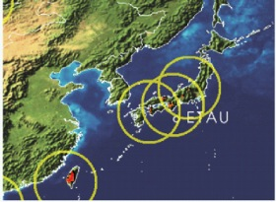
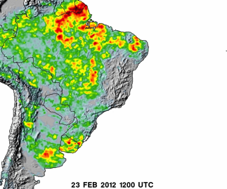
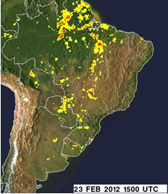
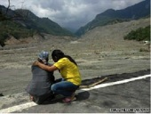
Landslides and flooding
GPM will provide rain accumulation and distribution data at high resolution to advance predictions of high-impact natural hazard events
Landslide Hazard Forecasting
Global Flood Modeling
Typhoon Morakot (Etau) August 8th, 2009
Over 500 people killed in Shiao Lin, triggered numerous and massive landslides throughout Southern and Central Taiwan
GPM will enhance modeling capabilities to estimate potentially susceptible areas to rainfall-triggered landslides.
Real-time estimates of flood areas using satellite rainfall and a hydrological model updated globally, every 3 hrs

Slide 14
Climate Modeling and Numerical Weather Prediction (NWP)
Rainfall accumulation for NWP
Modeling short and long-term fluctuations in climate and the water cycle
Hurricane Earl
Precipitation observations are in use at ECMWF, NCEP, JMA, and other NWP centers to improve weather forecasting.

Slide 15
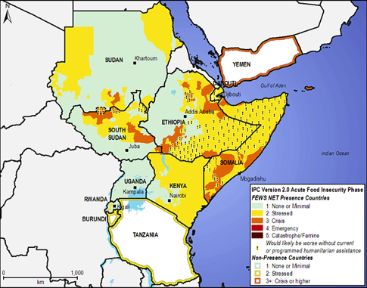
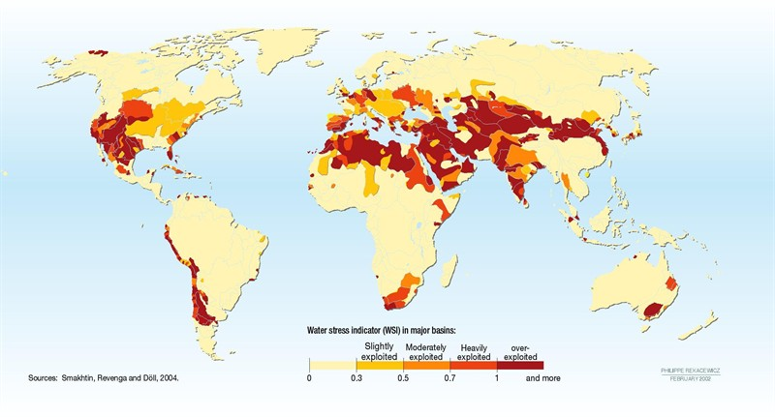
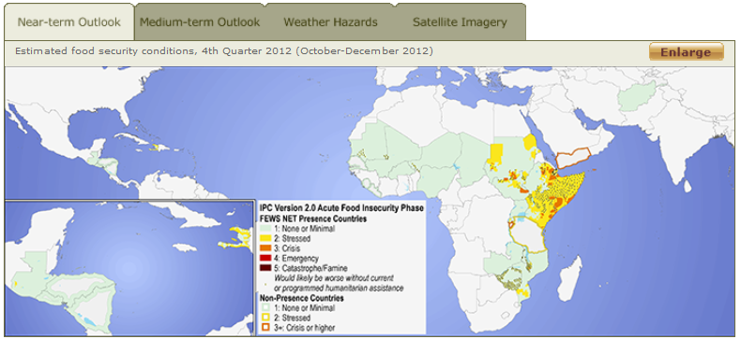
Freshwater availability and agriculture
Oct-Dec 2012 Outlook
Areas experiencing water stress
Accurate satellite precipitation estimates are critical to crop forecasts. Famine Earth Warning System (FEWS) relies on TRMM and other satellite estimates for anticipating poor growing seasons.
http://www.fews.net

Slide 16
World Health & Disease Outbreak
TRMM data has been used to estimate and trace the source areas of vector and river-borne diseases in Africa and Western Australia. Examples include Schistosomiasis (snail-spread) in Ethiopia.
Schuster et al. (2011), International Journal of Health Geographics, Vol. 10: 8, 1-14.
Courtesy of Bitew and Gebremichael
Notes:
Dalia

Slide 17
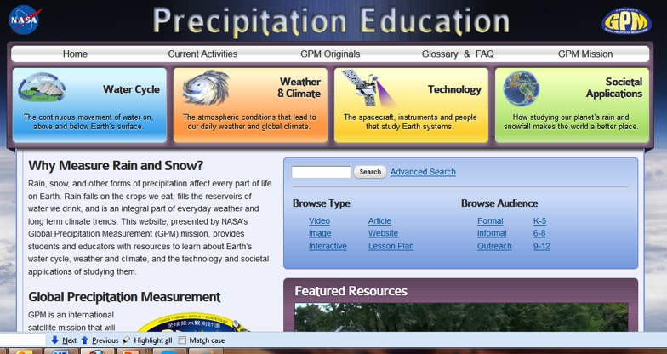
Educational resources available to you!
What can you do?
Follow us on Twitter: @NASA_Rain
“Like” us on Facebook: https://www.facebook.com/NASA.Rain
Precipitation Education Website: www.pmm.nasa.gov/education
Notes:
Dalia

Slide 18
GPM Education and Public Outreach
Formal Education:
Master Teachers: working with teachers to develop curriculum based on GPM themes
Outdoor Education: “Survivor Module” based on measuring water in different environments
Informal Education:
Earth to Sky partnership: stipends to National Parks, Fish and Wildlife Centers, etc. to develop an activity for their park
Student Ambassadors: Working with college students to develop K-12 activities that can be used in a variety of venues
CoCoRaHS: citizen science rain and snow collection
Outreach:
Science on a Sphere show, “Water Falls” premiering in October
Social Media, websites, Photo contests, Anime Character Challenge
Videos, feature stories, Google+ Hangouts, LEGO Model
Family Science Nights

Slide 19
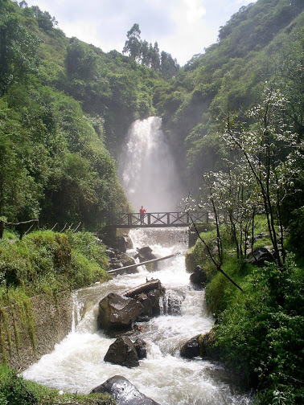
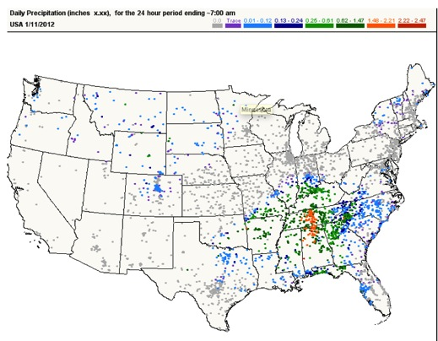
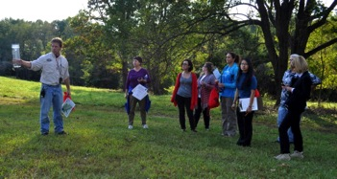
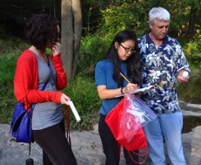
Other E/PO Activities
CoCoRaHS Citizen Science (Community Collaborative Rain, Hail and Snow Network (CoCoRaHS; www.cocorahs.org)
Network of individuals that take daily measurements of precipitation from rain gauges at their houses or other facilities
Teacher Activities
Master Teachers: Developing materials with GPM themes to be taught in middle school Earth Science classes
Outdoor Education Program called “Survivor” that is being tested within the Montgomery County system
mPING App development: citizen science precipitation reports
Anime Character Challenge
GPM Science on a Sphere show: “Water Falls”
Coming in October 2013!

Slide 20
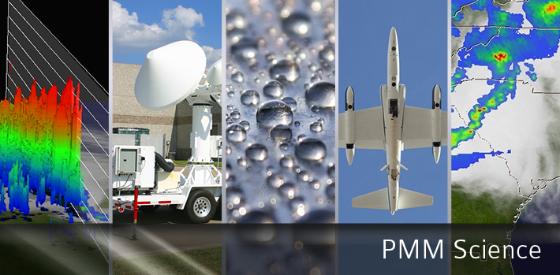
For more information on the TRMM and GPM Missions:
http://gpm.nasa.gov
www.nasa.gov/gpm
Twitter: NASA_Rain Facebook: NASA.Rain
Notes:
Gail/Dalia

