Slide 1
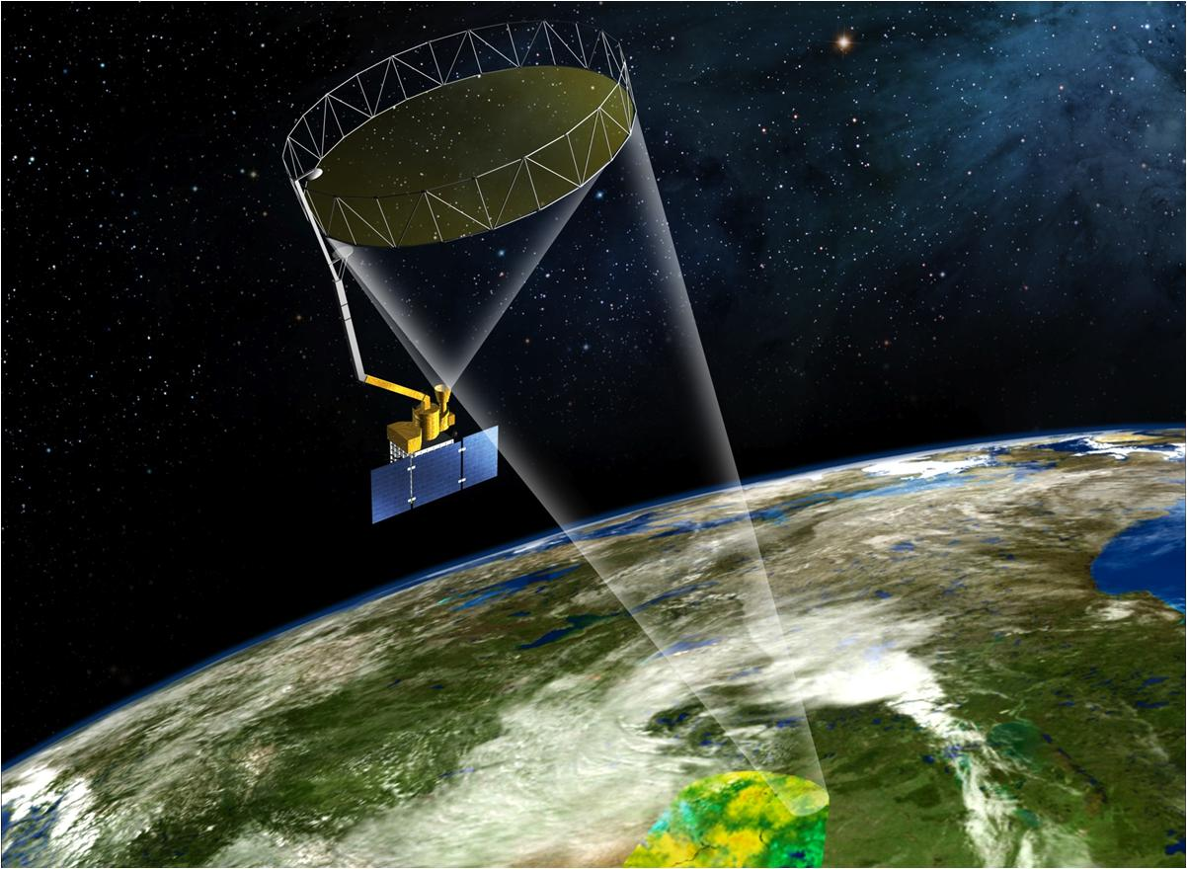

NASA’s Soil Moisture Active Passive (SMAP) Mission
Peggy O’Neill, NASA GSFC
SMAP Deputy Project Scientist
SMAP-GPM Joint Mission
Teacher Workshop
GSFC Visitor’s Center
June 26, 2013

Slide 2


Water is Important!
Water is Vital for Life
. . . and is part of the Earth’s integrated
physical system.
Soil moisture is an important part of
this system:
Soil moisture controls the amount of rain which infiltrates into the soil
vs running off into streams, and provides feedback between the land
and atmosphere [WATER CYCLE]
2. Soil moisture impacts the growth of vegetation, and its freeze/thaw
state affects the length of the growing season [CARBON CYCLE]
3. Soil moisture influences the exchange of latent & sensible heat energy
between the land surface and the atmosphere [ENERGY CYCLE]

Slide 3
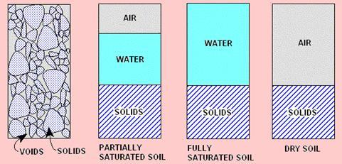
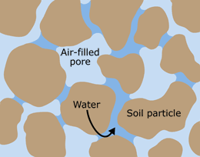
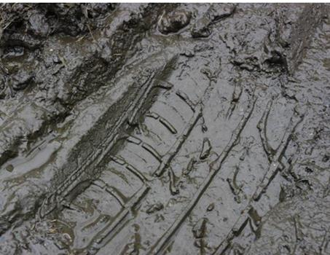
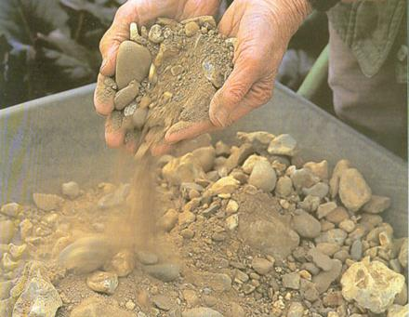
What is Soil Moisture?
1 m
1 m
1 m
very wet ...
very dry ...
Soil Moisture = _Volume of water_____
Volume of soil matrix
Units are cm³ / cm³ or m³ / m³ [sometimes %]
Ex. Volumetric soil moisture = 0.25 cm³/cm³ or 0.25 m³/m³
or 25%

Slide 4
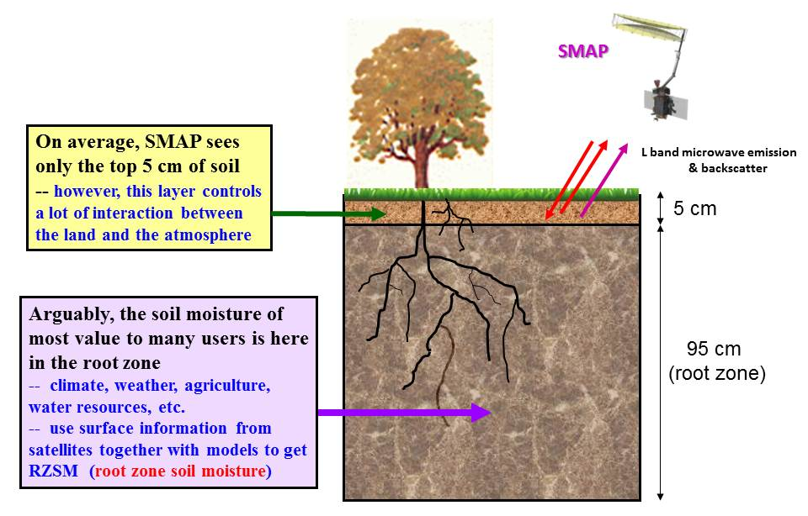
Surface and Root Zone Soil Moisture

Slide 5

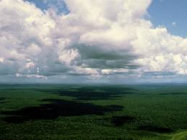
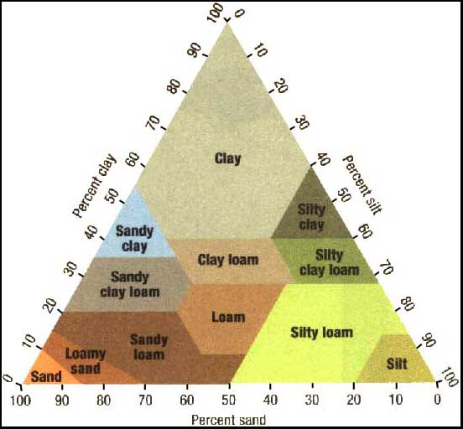
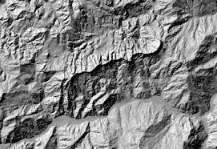
Soil Moisture is Variable
Soil moisture varies with space and time.
Primary factors that influence the distribution of soil moisture are:
Rainfall
Vegetation
Soil Texture
Topography

Slide 6
How might soil moisture influence air temperature?
…causing soil
moisture to
increase...
Precipitation
wets the
surface...
…which, through evaporative cooling, leads to cooler temperatures during subsequent days and weeks.
…which causes
evaporation to
increase during
subsequent days
and weeks...
OR the opposite, where no precipitation wets the surface and air temperatures increase ...

Slide 7
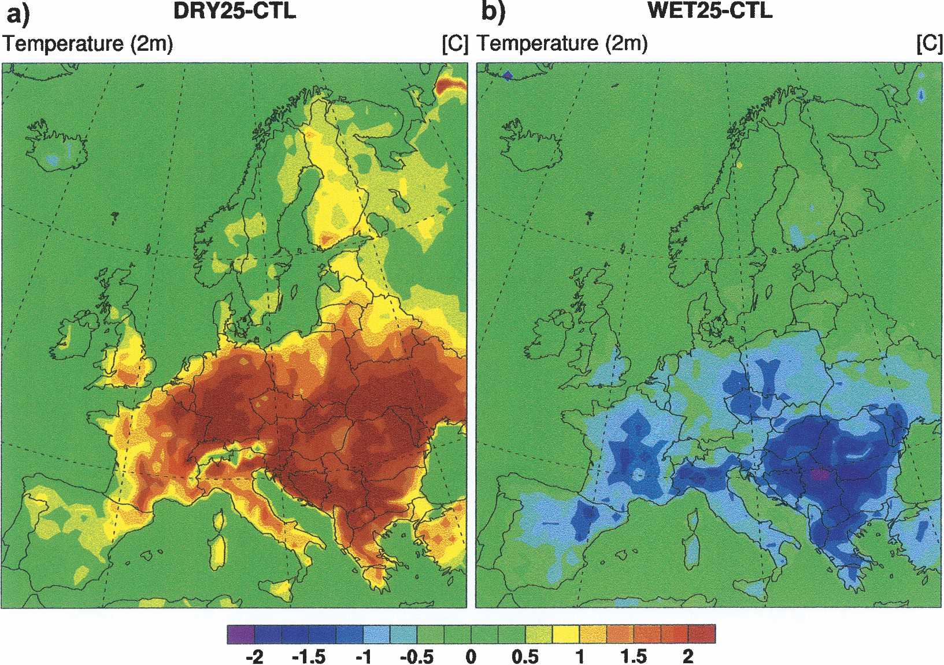
Human Health Application
European heatwave cause 35,000 deaths,
New Scientist, Oct. 2003.
Seasonal Climate Prediction:
50 km Resolution
Initialize root zone moisture
Fischer et al. (2007), J. of Climate, 20.

Slide 8
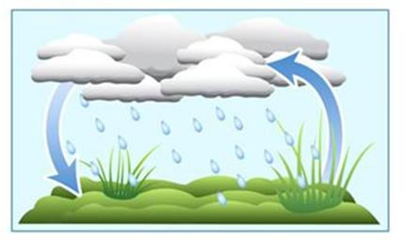
How might soil moisture influence precipitation?
…which affects the overlying atmosphere (the boundary layer structure, humidity, etc.) ...
…thereby (maybe)
inducing additional precipitation
…which causes
evaporation to
increase during
subsequent days
and weeks...
Precipitation wets
the surface...
…causing soil moisture to
increase...

Slide 9
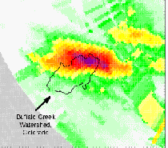
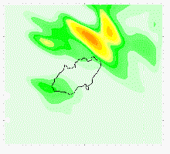
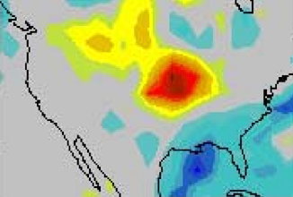
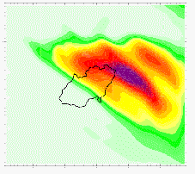
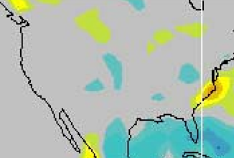
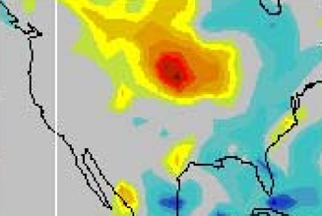
Value of Soil Moisture Data to Weather & Climate
New space-based soil moisture observations and data assimilation modeling can improve forecasts of local storms and seasonal climate anomalies
NWP Rainfall Prediction
Seasonal Climate Predictability
Predictability of seasonal climate is dependent on boundary conditions such as sea surface temperature (SST) and soil moisture – soil moisture is particularly important over continental interiors.
Difference in Summer Rainfall: 1993 (flood) minus 1988 (drought) years
Buffalo Creek
Basin
Observed Rainfall
0000Z to 0400Z 13/7/96
(Chen et al., 2001)
Without Realistic Soil Moisture
Observations
24-Hours Ahead High-Resolution Atmospheric Model Forecasts
Prediction driven just by SST
Prediction driven by SST and soil moisture
With Realistic Soil Moisture
High resolution soil moisture data will improve numerical weather prediction (NWP) over continents by accurately initializing land surface states
(Schubert et al., 2002)
-5 0 +5
Rainfall Difference [mm/day]

Slide 10

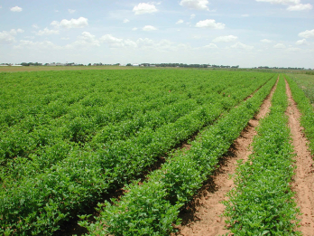
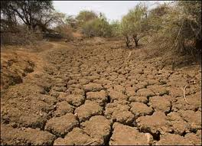


Applications of Soil Moisture
Better/enhanced weather & climate forecasting
More accurate agriculture productivity
Drought early warning
Extent of flooding (prediction & monitoring)
Human health and vector borne disease

Slide 11
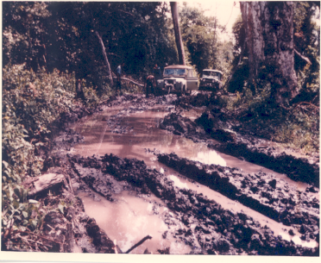
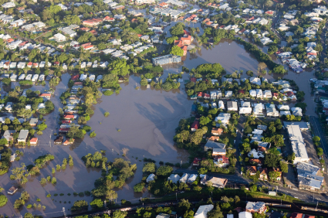

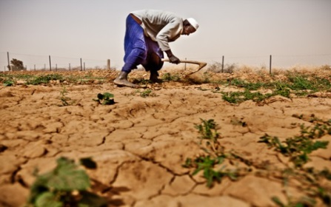
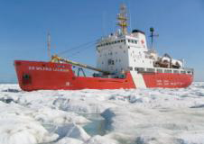
Applications of Soil Moisture (2)
Trafficability -- farming, military, and disaster relief
operations
Insurance sector / flood risk
Dust storms
Famine early warning
Sea Ice (obviously not soil moisture but SMAP microwave
measurements are useful)

Slide 12
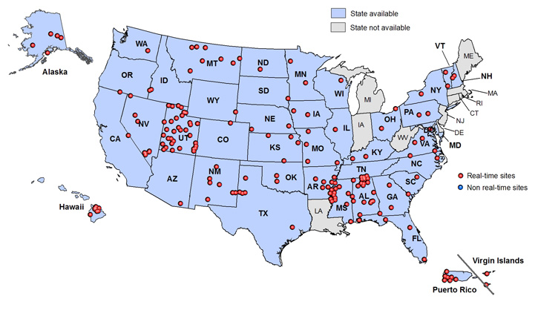
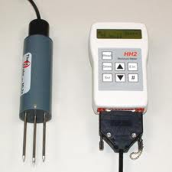
Direct Measurements Lacking Globally
In situ measurements (direct/point measurements)
Support scale 10 – 50 cm
Gravimetric soil sampling
is often used, but is labor
intensive and spatial
coverage is limited
Theta Probe
USDA SCAN soil moisture network across United States

Slide 13
MICROWAVE REMOTE SENSING
Provides all-weather, day-night, large-area measurement capability
Strong theoretical basis for measurement of soil moisture based on the large change in the soil dielectric constant with moisture
L band frequency (1.4 GHz or 21 cm wavelength) most sensitive to soil moisture while minimizing secondary effects of vegetation and surface roughness
Responds most strongly to soil moisture in the 0-5 cm surface layer (average soil under average conditions)

Slide 14
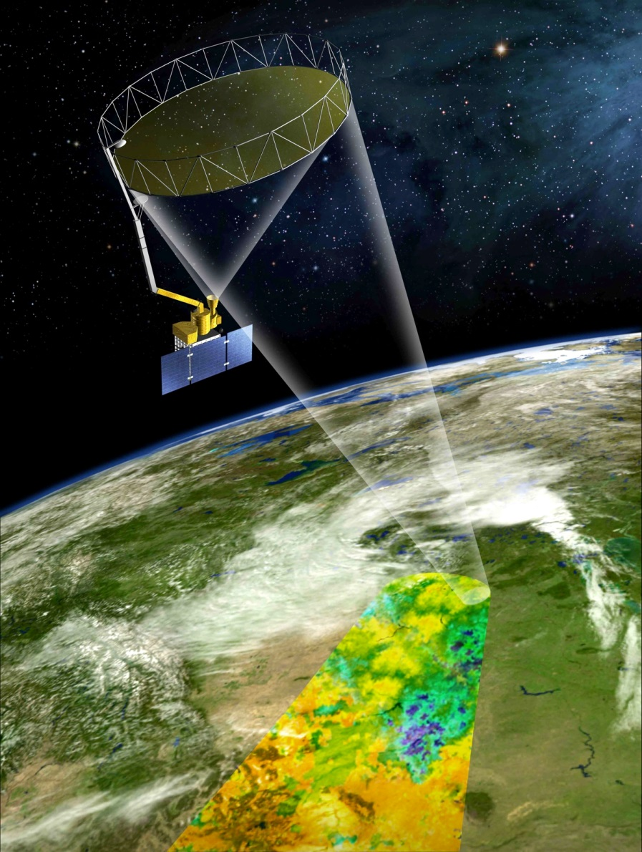
NASA’s SMAP Mission

Slide 15

Mission Context
SMAP is one of four Tier-1 missions recommended by the U.S. NRC Earth Science Decadal Survey
Tier 1:
 | Soil Moisture Active Passive (SMAP)
 | ICESAT II
 | DESDynI
 | CLARREO
Tier 2:
 | SWOT
 | HYSPIRI
 | ASCENDS
 | GEO-CAFE
 | ACE
Tier 3:
 | LIST
 | PATH
 | GRACE-II
 | SCLP
 | GACM
 | 3D-WINDS
“Earth Science and Applications from Space: National Imperatives for the next Decade and Beyond”
(National Research Council, 2007) http://www.nap.edu
SMAP was initiated by NASA as a new start mission in February 2008
SMAP is a joint mission by GSFC and JPL, with project
management responsibility at JPL
SMAP in currently in Phase D – Integration & Test
Target launch date for SMAP is October 2014
Notes:
15
15
Oct. 23, 2008
15
15

Slide 16
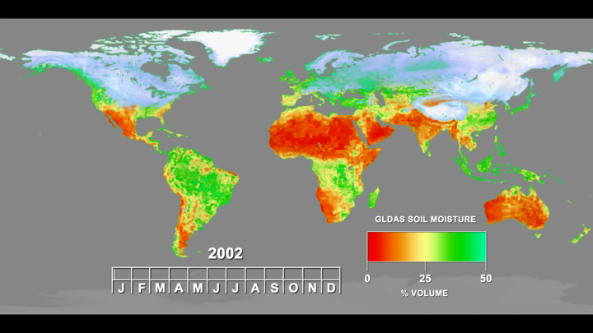
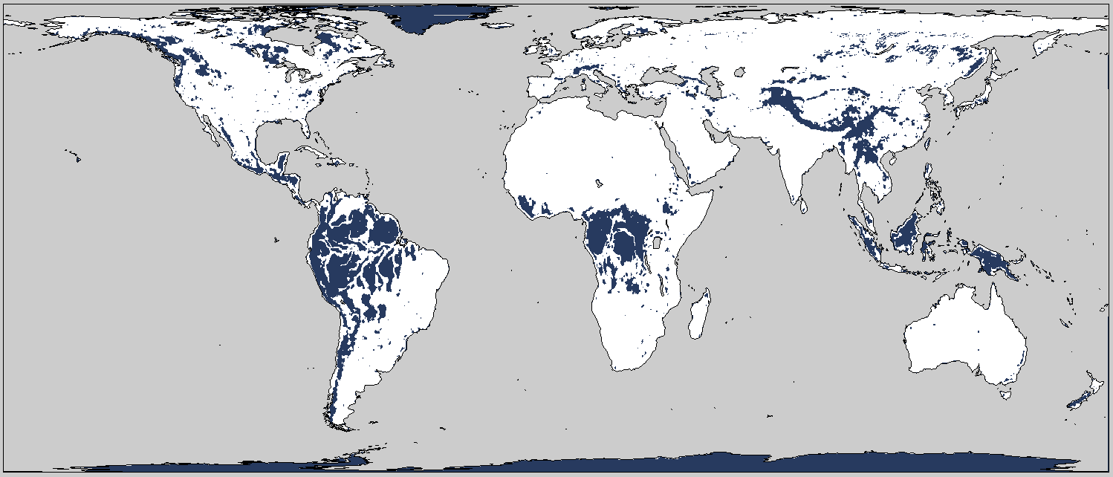
Science Objectives
SMAP will provide high-resolution, frequent-revisit global mapping of soil moisture and freeze/thaw state to enable science and applications users to:
Model simulation of SMAP L4 Soil Moisture Product
  Understand processes that link the terrestrial water, energy and carbon cycles
  Estimate global water and energy fluxes at the land surface
  Quantify net carbon flux in boreal landscapes
  Enhance weather and climate forecast skill
  Develop improved flood prediction and drought monitoring capability
Regions where soil moisture retrieval is limited
(dense vegetation, topography, snow/ice)
SMAP data will also be used in applications of societal benefit that range from agriculture to human health.

Slide 17
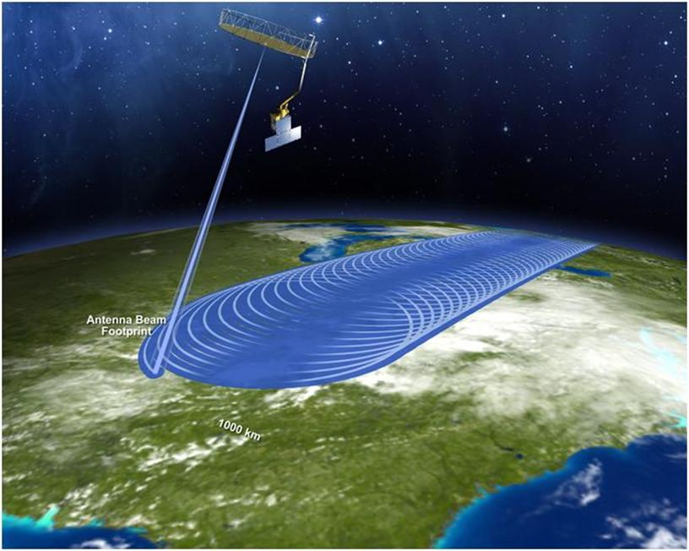
Measurement Approach
Instruments:
  Radiometer: L-band (1.4 GHz)
    V, H, 3rd & 4th Stokes parameters
    40 km resolution
    Moderate resolution soil moisture (high accuracy )
  Radar: L-band (1.26 GHz)
    VV, HH, HV polarizations
    1-3 km resolution (SAR mode); 30 x 5 km resolution (real-aperture mode)
    High resolution soil moisture (moderate accuracy) and Freeze/Thaw state detection
  Shared Antenna
    6-m diameter deployable mesh antenna
    Conical scan at 14.6 rpm
    Constant incidence angle: 40 degrees
    -- 1000 km-wide swath
    -- Swath and orbit enable 2-3 day global revisit
Orbit:
  -- Sun-synchronous, 6 am/pm,
  685 km altitude
  -- 8-day exact repeat
Mission Operations:
-- 3-year baseline mission
-- Launch target is October 2014

Slide 18
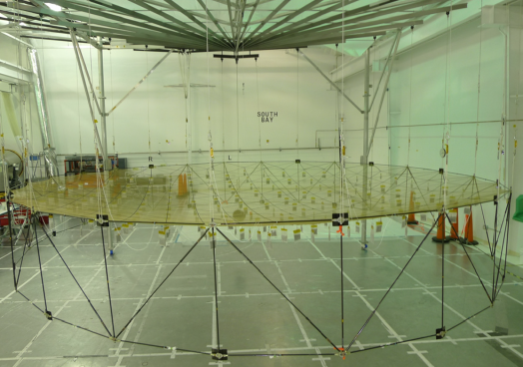
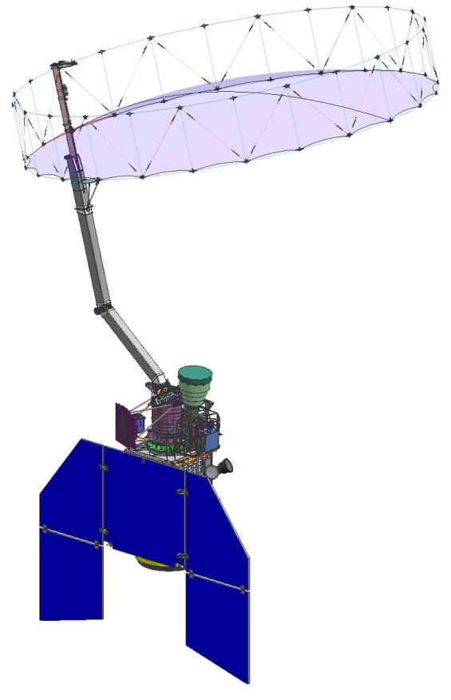
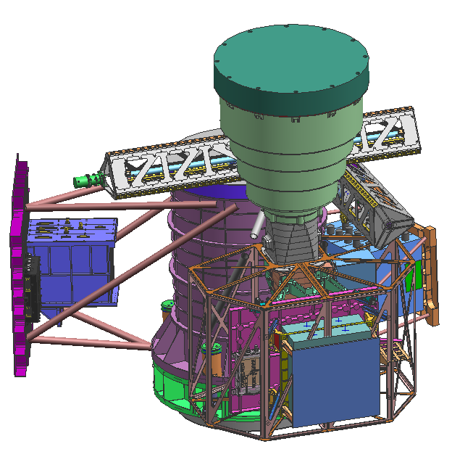
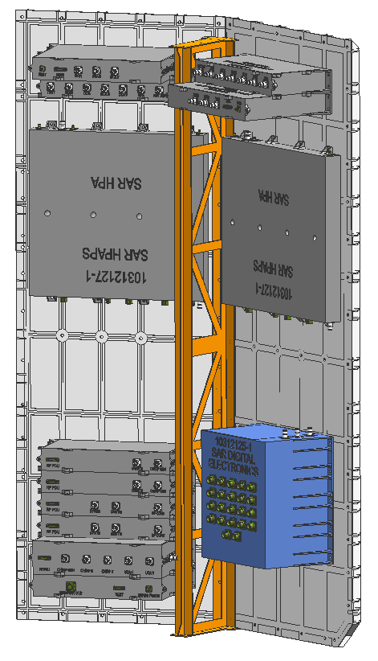
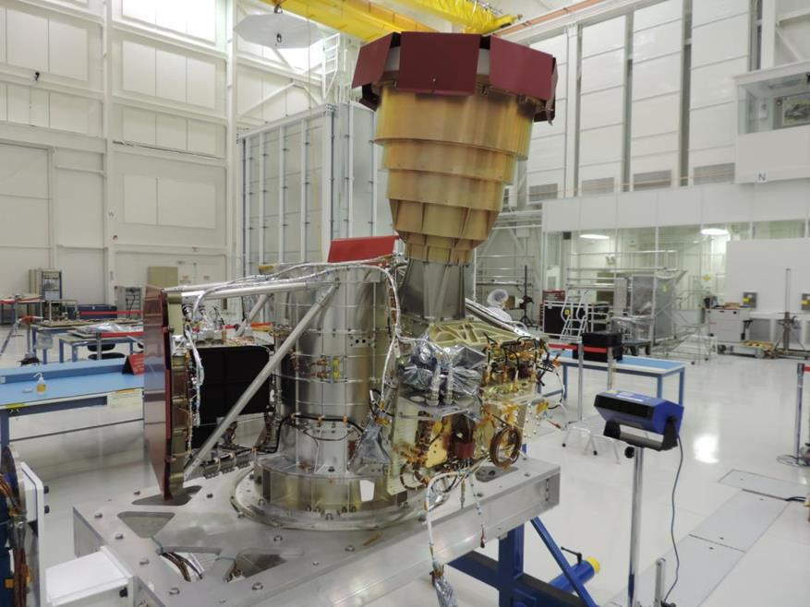
Instrument Overview
Spun instrument
assembly
Radiometer is spun-side mounted to reduce losses
Radar is fixed-mounted to reduce spun inertia
Radiometer
  Provided by GSFC
  Leverages off Aquarius radiometer design
  Includes RFI mitigation (spectral filtering)
Common 6 m spinning reflector
  Enables global coverage in 2-3 days
  Spin Assembly (provided by Boeing) and Reflector Boom Assembly (provided by NGST-Astro) have extensive heritage
Radar
  Provided by JPL
  Leverages off past JPL L-band science radar designs
  RFI mitigation through tunable frequencies & ground processing
Notes:
18

Slide 19

SMAP Data Products
Product | Short Description | Gridding (Resolution) | Latency**
L1A_S0 | Radar raw data in time order | – | 12 hours | Instrument Data
L1A_TB | Radiometer raw data in time order | – | 12 hours
L1B_S0_LoRes | Low resolution radar σ_{o} in time order | (5x30 km) | 12 hours
L1B_TB | Radiometer T_{B} in time order | (36x47 km) | 12 hours
L1C_S0_HiRes | High resolution radar σ_{o} | 1 km (1-3 km)* | 12 hours
L1C_TB | Radiometer T_{B} | 36 km | 12 hours
L2_SM_A | Soil moisture (radar) | 3 km | 24 hours | Science Data (Half-Orbit)
L2_SM_P | Soil moisture (radiometer) | 36 km | 24 hours
L2_SM_A/P | Soil moisture (radar/radiometer) | 9 km | 24 hours
L3_SM_A | Soil moisture (radar) | 3 km | 50 hours | Science Data (Daily Composite)
L3_F/T_A | Freeze/thaw state (radar) | 3 km | 50 hours
L3_SM_P | Soil moisture (radiometer) | 36 km | 50 hours
L3_SM_A/P | Soil moisture (radar/radiometer) | 9 km | 50 hours
L4_SM | Soil moisture (surface & root zone) | 9 km | 7 days | Science Value-Added
L4_C | Carbon net ecosystem exchange (NEE) | 9 km | 14 days
* Over outer 70% of swath
** The SMAP Project will make a best effort to reduce the data latencies beyond those shown in this table.

Slide 20


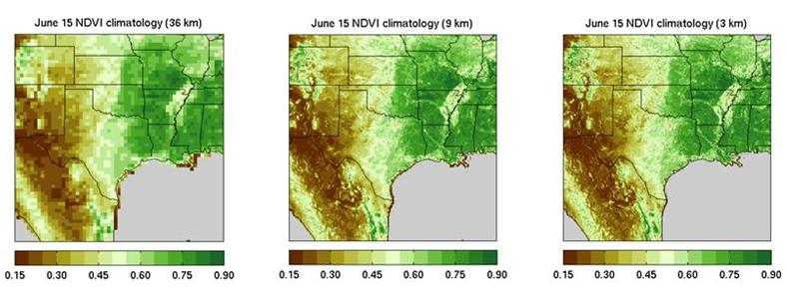
SMAP Spatial Grids
(a) Perfect nesting in SMAP EASE grids
36 km
All SMAP baseline products will be output on
one of the SMAP standard EASE2* grids
SMAP grids are perfectly nested to facilitate
working between different products at
different scales
* Equal-Area Scalable Earth-2 grid
(b) Example of ancillary NDVI climatology data displayed on the SMAP 36-km, 9-km, and 3-km EASE grids

Slide 21
SMAP Mission Summary (1)
SMAP is a planned NASA Earth Science Decadal Survey Mission
Launch currently scheduled for October 2014 into a 6 am / 6 pm
sun-synchronous orbit for a planned 3-year mission
Will use an L-band radar & radiometer to measure global soil
moisture & freeze/thaw every 2-3 days
Baseline SMAP data products include:
-- radar-derived F/T at 3 km resolution
-- radiometer-only SM at 40 km resolution
-- combined radar/radiometer SM at 9 km resolution
-- value-added products (root zone SM, carbon NEE) at 9 km
All SMAP products output on nested 3, 9, 36 km EASE2 grids
Notes:
21

Slide 22
Summary (2)
SMAP provides high-resolution and frequent-revisit global mapping of soil moisture and freeze/thaw state that has:
  Science value for Water, Carbon and Energy Cycles
  Applications in Operational Weather Forecasting, Flood & Drought Monitoring, Agriculture, & other areas of benefit to society
  Addresses priority questions on Climate and Climate Change
  Leverages Hydros, Aquarius, and SMOS risk reduction, expertise, and
  lessons learned
Project is currently in Phase D – Integration & Test of Flight Hardware
Provides synergism with GPM
-- SMAP provides GPM with a better land surface background for improved
estimation of rainfall over land
-- GPM provides SMAP with better rainfall input into land surface models and
a potential rain flag needed in the soil moisture retrievals
Project has and will continue to reach out to the broad science, EPO,
and applications communities
Notes:
22
22
22

Slide 23

Thank You!

Slide 24
BACKUP

Slide 25
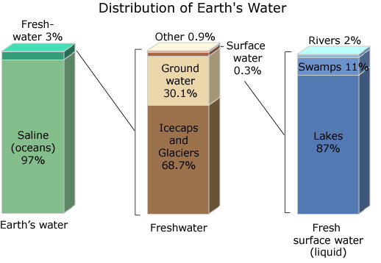
Distribution of Earth’s water
Water source | Water volume, in cubic miles | Water volume, in cubic kilometers | Percent of fresh water | Percent of total water | Residence time
Oceans, Seas, & Bays | 321,000,000 | 1,338,000,000 | -- | 96.5 | 3,200 years
Ice caps, Glaciers, & Permanent Snow | 5,773,000 | 24,064,000 | 68.7 | 1.74 | 20 to 100 years
Groundwater | 5,614,000 | 23,400,000 | -- | 1.7 | 10,000 year
Fresh | 2,526,000 | 10,530,000 | 30.1 | 0.76
Saline | 3,088,000 | 12,870,000 | -- | 0.94
Soil Moisture | 3,959 | 16,500 | 0.05 | 0.001 | 1 to 2 months
Ground Ice & Permafrost | 71,970 | 300,000 | 0.86 | 0.022 | 20,000 years
Lakes | 42,320 | 176,400 | -- | 0.013 | 50 to 100 years
Fresh | 21,830 | 91,000 | 0.26 | 0.007
Saline | 20,490 | 85,400 | -- | 0.006
Atmosphere | 3,095 | 12,900 | 0.04 | 0.001 | 9 days
Swamp Water | 2,752 | 11,470 | 0.03 | 0.0008
Rivers | 509 | 2,120 | 0.006 | 0.0002 | 2 to 6 months
Biological Water | 269 | 1,120 | 0.003 | 0.0001
Total | 332,500,000 | 1,386,000,000 | - | 100
Source: Gleick, P. H., 1996: Water resources. In Encyclopedia of Climate and Weather, ed. by S. H. Schneider, Oxford University Press, New York, vol. 2, pp.817-823.

Slide 26
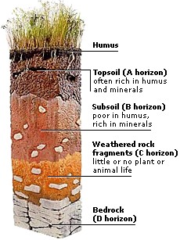
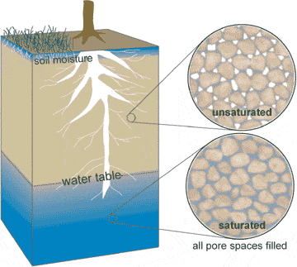
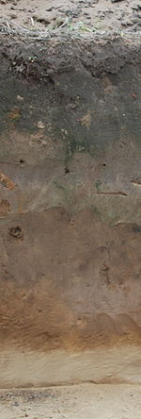
Example of Soil Profile

Slide 27
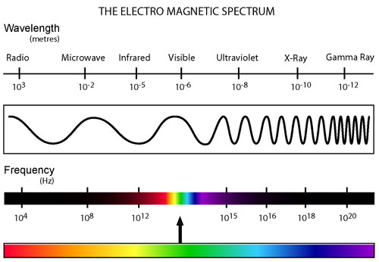

Slide 28
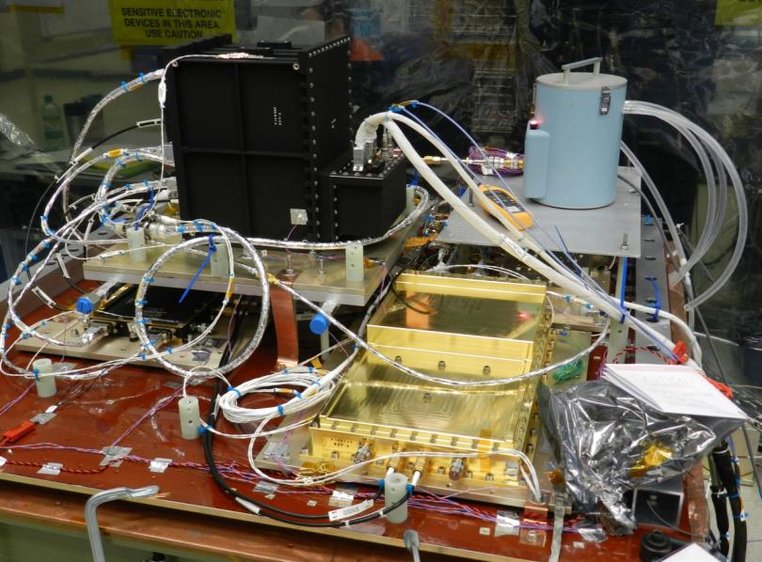
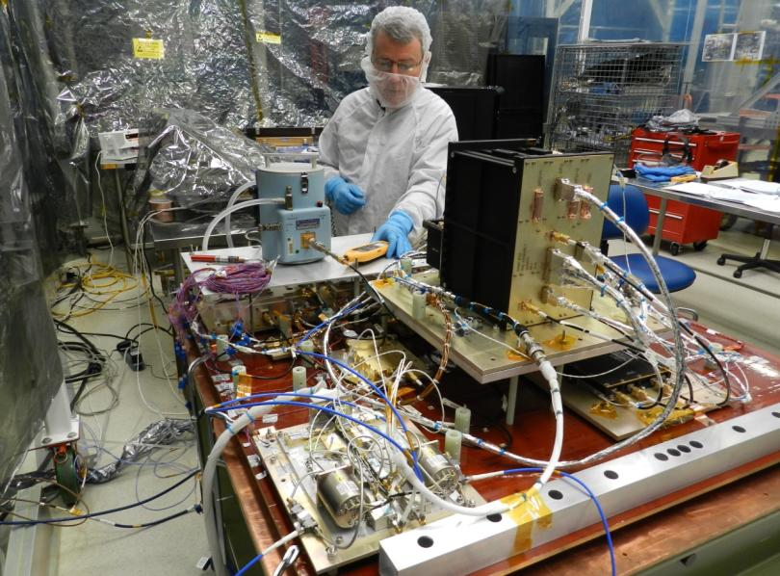
Significant Events (GSFC)
FM Radiometer: LN2 Bucket Test

Slide 29
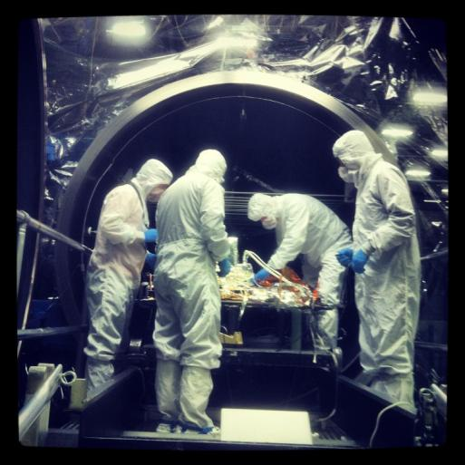
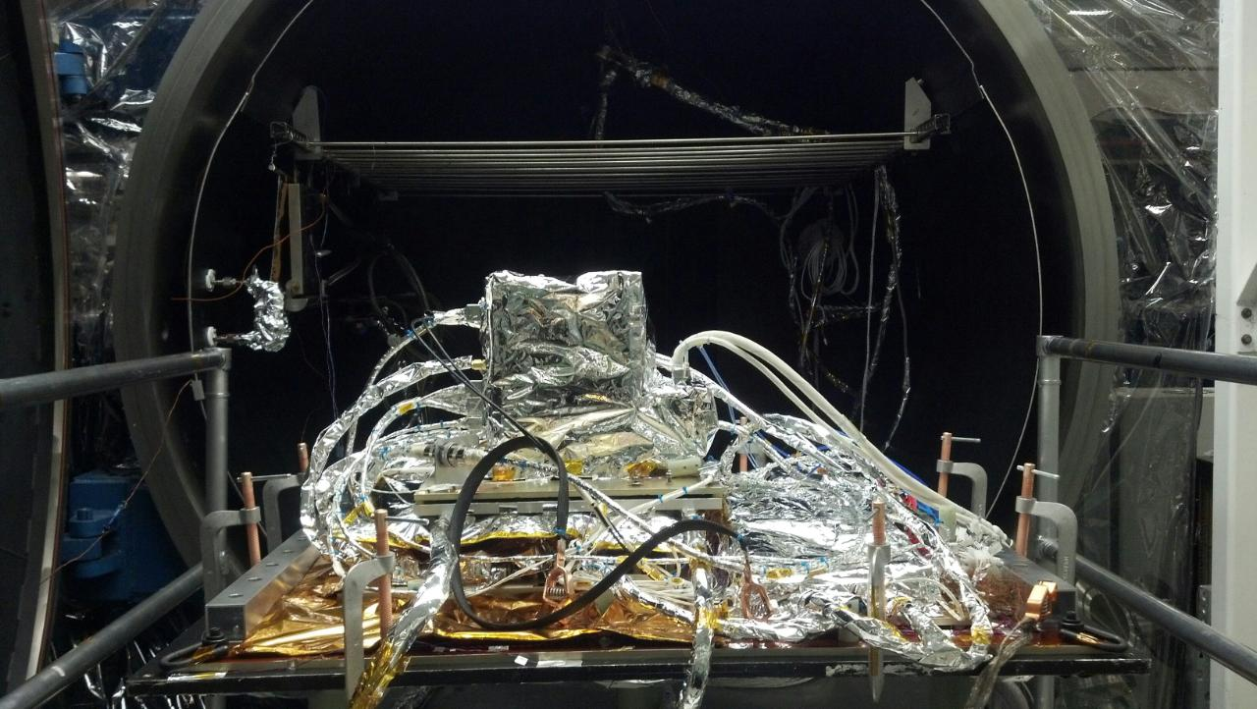
Significant Events (GSFC)
Radiometer System at TVAC Chamber 239 for Testing

Slide 30
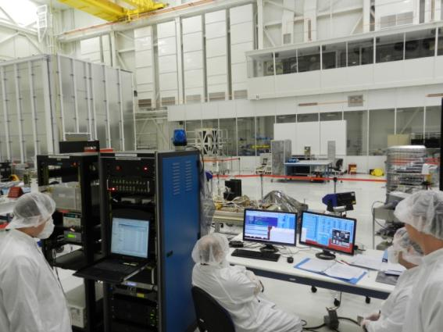
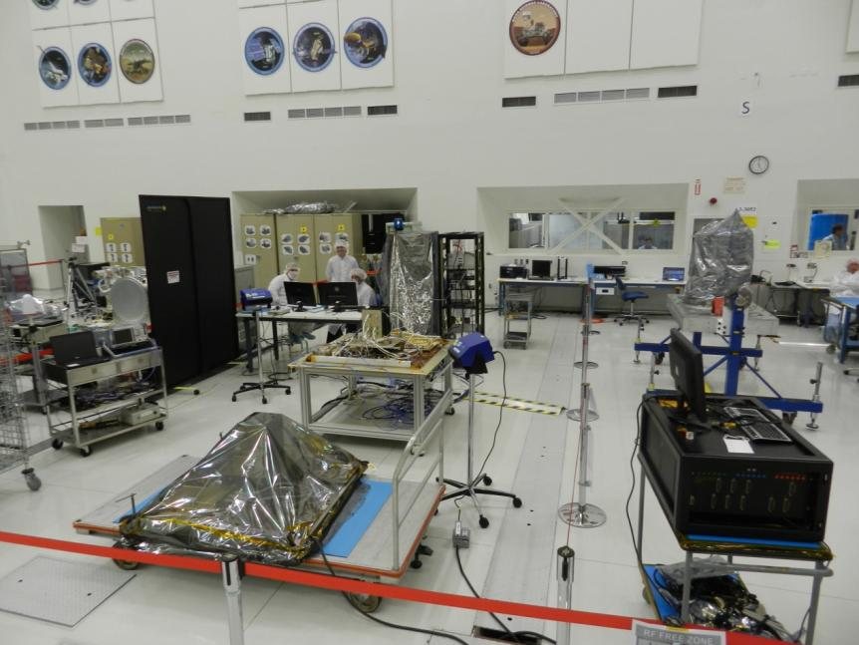
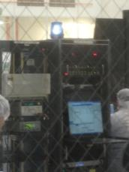
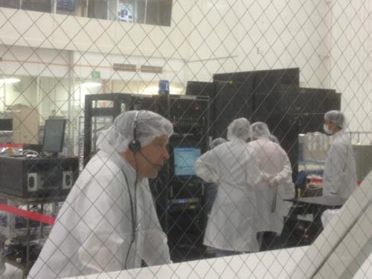
Significant Progress (JPL)
Post-Ship Setup and Test – May 6-10, 2013

Slide 31

Radiometer installed on the Core Structure at JPL

Slide 32
Interested in joining a SMAP Working Group?
Sign up at http://smap.jpl.nasa.gov/science/wgroups
Algorithms Working Group (AWG)
Calibration & Validation Working Group (CVWG)
Radio-Frequency Interference Working Group (RFIWG)
Applications Working Group (AppWG)

Slide 33
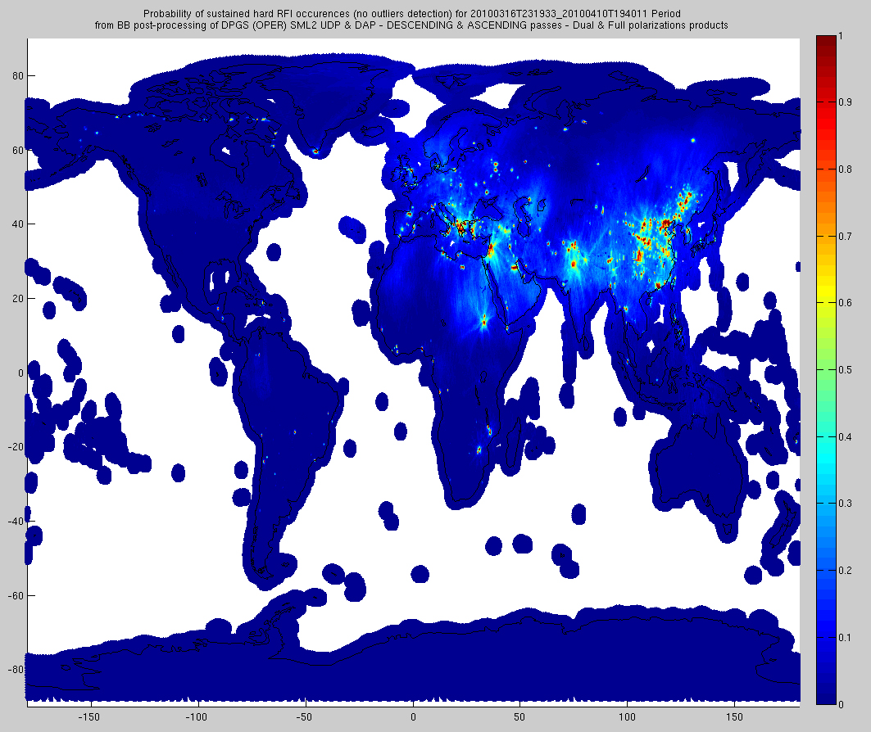
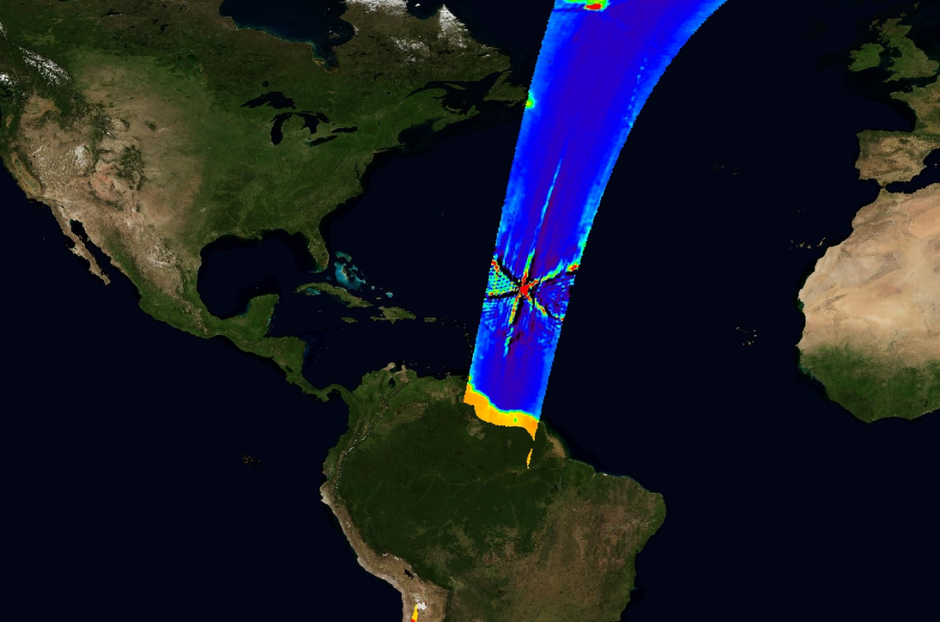
Anthropogenic Radio-Frequency Interference (RFI)
RFI is evident
and wide-spread
(Data from SMOS)
SMAP is taking aggressive measures to detect and mitigate RFI in its instrument and data processing designs.

Slide 34

Candidate Global SMAP Cal/Val Sites

Slide 35
Cal/Val Objectives
Pre-Launch objectives:
  Acquire and process data with which to calibrate, test, and improve models and algorithms used for retrieving SMAP science data products
  Develop and test the infrastructure and protocols for post-launch validation; this includes establishing an in situ observation strategy for the post-launch phase
Post-Launch objectives:
  Verify and improve the performance of the science algorithms
  Validate accuracies of the science data products as specified in L1 Requirements
Requirement | Baseline Mission
 | Soil Moisture | Freeze/Thaw
Resolution | 10 km | 3 km
Refresh Rate | 3 days | 2 days⁽¹⁾
Accuracy | 0.04 [cm³/cm³] (1-σ) | 80% [binary classification]
⁽¹⁾ North of 45N latitude

Slide 36
Algorithm Needs
All baseline SMAP products have associated algorithm(s) which
require a variety of ancillary data to meet retrieval accuracies:
-- 0.04 cm³/cm³ for soil moisture within SMAP land mask
-- 80% classification accuracy for binary F/T in boreal latitudes
Areas of snow/ice, frozen ground, mountainous topography, open
water, urban areas, and dense vegetation (> 5 kg/m²) are excluded
from SM accuracy statistics
Static ancillary data do not change during mission
-- permanent masks (land/water/forest/urban/mountain), DEM, soils
Dynamic ancillary data require periodic updates ranging from daily
to seasonally
-- soil T, precipitation, vegetation, surface roughness, land cover

Slide 37
Ancillary Parameter Choices
Anticipated Primary Sources of Ancillary Parameters
1 | Soil Temperature | GMAO or ECMWF forecast temperatures (TBD)
2 | Surface Air Temperature | GMAO or ECMWF forecast temperatures (TBD); FLUXNET towers for F/T
3 | Vegetation Water Content (VWC) | MODIS NDVI [Tom Jackson & R. Hunt approach]
4 | Sand & Clay fraction | Combination of HWSD (global), regional data sets (STATSGO-US, ASRIS-Australia, NSD-Canada), FAO
5 | Urban Area | GRUMP data set – Columbia University
6 | Open Water Fraction | a priori static water fraction from MODIS MOD44W to be used in conjunction with open water fraction from SMAP HiRes radar
7 | Crop Type | combination of USDA Cropland Data Layer, AAFC-Canada, Ecoclimap-Europe
8 | Land Cover Class | MODIS IGBP; crop class will be further subdivided into four general crop types
9 | Precipitation | ECMWF total precipitation forecasts (with GPM once launched as possible supplement)
10 | Snow | Snow & Ice Mapping System (IMS) - NOAA
11 | Mountainous Area [DEM] | combination of SRTM, Alaska USGS DEM, Canada Geobase DEM, and GTOPO30
12 | Permanent Ice | MODIS IGBP
13 | b, ω, and τ Vegetation Parameters | land cover-driven table lookup
14 | h Roughness Parameter | land cover-driven table lookup
Notes:
37
37
37

Slide 38


Flood and Drought Applications
Current: Empirical Soil Moisture Indices Based on Rainfall and Air Temperature
(By Counties >40 km and Climate Divisions >55 km )
Future: SMAP Soil Moisture Direct Observations of Soil Moisture at 9 km

Slide 39


Carbon Budget in Boreal Landscapes
Normal to late thaw (May):
Carbon Source
[1995, 1996, 1997]
Early thaw (April 22): Carbon Sink
[1998]
5/7
5/27
5/26
4/22
Spring thaw dates
A given location can be a net source or net sink of carbon, depending on freeze / thaw date. SMAP freeze / thaw measurements can help reduce errors in the closing of the carbon budget.
Goulden et al., 1998: Sensitivity of Boreal Forest Carbon Balance to Soil Thaw, Science, 279.
Herring, D. and R. Kannenberg: The mystery of the missing carbon, NASA Earth Observatory.

Slide 40
SMAP Level 1 Science Requirements
 | Science Discipline Measurement Need |  |  | Level 1 Science Measurement Requirements
 | Hydro-Meteorology | Hydro-Climatology | Carbon Cycle | Baseline Mission |  | Threshold Mission
 |  |  |  | Soil Moisture | Freeze/ Thaw² | Soil Moisture | Freeze/ Thaw²
Resolution | 4–15 km | 50–100 km | 1–10 km | 10 km | 3 km | 10 km | 10 km
Refresh Rate | 2–3 days | 3–4 days | 2–3 days | 3 days | 2 days | 3 days | 3 days
Accuracy⁽¹⁾ | .04–.06 cm³/cm³ | .04–.06 cm³/cm³ | 80–70% | .04 cm³/cm³ | 80% | .06 cm³/cm³ | 70%
Mission Duration Requirement:
3 Years Baseline; 18 Months Threshold
⁽¹⁾ volumetric soil moisture content (1-sigma) ; % classification accuracy (binary Freeze/Thaw)
⁽²⁾ North of 45⁰ N latitude
DS Objective | Application/Discipline | Science Requirement
Weather Forecast | Initialization of Numerical Weather Prediction (NWP) | Hydrometeorology
Climate Prediction | Boundary and Initial Conditions for Climate Models | Hydroclimatology
 | Testing Land Surface Models in General Circulation Models
Drought and Agriculture Monitoring | Seasonal Precipitation Prediction | Hydroclimatology
 | Regional Drought Monitoring
 | Crop Outlook
Flood Forecast | River Forecast Model Initialization | Hydrometeorology
 | Flash Flood Guidance (FFG)
 | NWP Initialization for Precipitation Forecast
Human Health | Seasonal Heat Stress Outlook | Hydroclimatology
 | Near-Term Air Temperature and Heat Stress Forecast | Hydrometeorology
 | Disease Vector Seasonal Outlook | Hydroclimatology
 | Disease Vector Near-Term Forecast (NWP) | Hydrometeorology
Boreal Carbon | Freeze/Thaw Date | Freeze/Thaw State
Derived from models and decision-support tools used in areas of application identified by decadal survey for SMAP
Notes:
40
40
40

Slide 41

SMAP Temporal Resolution & Latency
SMAP Level 2 soil moisture data are output on a half-orbit basis representing
an instantaneous soil moisture value for the 0-5 cm surface layer at 6 am
local time
-- a 6 pm soil moisture product may be produced if resources permit
Level 3 soil moisture data are just global maps of all 6-am half orbit data in a
24-hr period
-- L3_FT data incorporate both 6 am & 6 pm data to document daily F/T transitions
L4_SM includes a model-generated 0-5 cm and 0-100 cm soil moisture
Latencies:
-- 12 hrs for L1 data
-- 24 hrs for L2 data
-- 50 hrs for L3 data
-- 7 days for L4_SM
-- 14 days for L4_C
Simulation of L3_SM_P retrieved surface volumetric soil moisture in cm³/cm³

Slide 42



Synergistic Data and Experience from
SMOS and Aquarius
SMAP complements SMOS and Aquarius:
  Extends global L-band radiometry beyond these missions (yields long-duration land hydroclimate soil moisture datasets)
  Significantly increases the spatial resolution of soil moisture data
  Adds characterization of freeze thaw state for carbon cycle science
  Adds substantial instrument and processing mitigations to reduce science degradation and loss from terrestrial RFI
SMAP benefits from strong mutual science team members’ engagements in missions
  SMOS & Aquarius data are important for SMAP’s algorithm development
  SMAP will collaborate in and extend SMOS & Aquarius Cal-Val campaigns
  SMOS and Aquarius will provide valuable data on the global terrestrial RFI environment which is useful to SMAP
SMOS (ESA)
2009 Launch
Aquarius
2011 Launch
Mission | LRD | Measurement | Instrument Complement | Resolution/Revisit
SMOS | Nov ’09 | Soil Moisture Ocean Salinity | L-band Radiometer | ~40 km / 3 days
Aquarius | June ’11 | Ocean Salinity Soil Moisture (experimental) | L-band Radiometer, Scatterometer | 100 km / 7 days
SMAP | Oct ’14 | Soil Moisture Freeze/Thaw State | L-band Radiometer, SAR (unfocused) | 9 km / 2-3 days
SMAP
2014 LRD
Notes:
42
42
42

