Slide 1
Global Energy Budget Lesson
Global Precipitation Measurement Mission
Developed by the GPM Education and Public Outreach Team
NASA Goddard Space Flight Center

Slide 2
Guiding Questions
Energy: What do radiation, reflection and absorption mean?
Energy on Earth: What factors can affect how energy is absorbed, reflected and radiated from Earth?
Heating Earth’s Surface Inquiry Lab: How does Earth “spend” it’s allowance of energy from the Sun?
Earth’s energy budget: How is Earth’s energy budget like a monetary budget?
Using Satellites: How does NASA use satellite data to study Earth’s energy budget?
Notes:
This slide could be shown to students as a preview of the lesson, or used solely as a reference for the teacher.

Slide 3
Engage
Important vocabulary words for today are radiation, reflection and absorption. Brainstorm a list of any words or phrases you think of related to those three.
Notes:
You might bring in examples of objects that are reflective - for example foil, or a reflective shade for a car windshield. For the latter, you could ask students why you would want to use such a thing, and if they have any experience of using them in a vehicle. The discussion of vocabulary could be shortened or left out for students with greater background knowledge, or extended for those (such as English language learners) who need extra support. See the Differentiation and Re-teaching section of this PowerPoint for word splash slides that could be used to extend the vocabulary discussion.
Shining a light bulb on students' hands is a good way to show radiation - they don't need to touch the bulb to feel the heat. This can then be related to the Sun's energy travelling through the vacuum of space.
For absorption, you could refer back to the car example, and if students have experienced different cars or car upholstery having a different temperature when exposed to the Sun. Although it's not energy precisely, a sponge is also a good visual example of absorption to use, especially for English Language Learners.

Slide 4
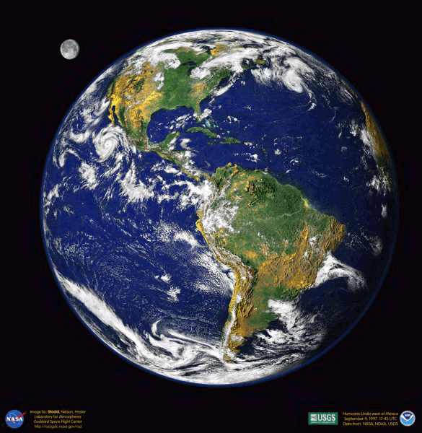
Think-Pair-Share
THINK: Look at the picture of the Earth. Think about any factors that might affect how energy is absorbed, radiated or reflected from Earth. Describe them and how they would make a difference (heating or cooling).
PAIR: Share at least one idea with your partner.
SHARE: Raise your hand if you'd like to share something you and your partner discussed.
Notes:
Students should notice the clouds, land and water. They may propose that clouds block the light, or notice the different colors on the land which would result in different amounts of energy absorbed and reflected. Other possible points of discussion are to compare the temperature of a parking lot and a grassy field on a warm day, or the sand at the beach and the water.

Slide 5
Reflection and Absorption Animation
Source: NASA/Goddard Space Flight Center Conceptual Image Lab
For more information or other formats of this animation, go to: http://svs.gsfc.nasa.gov/goto?20094
Notes:
For more information or other formats of this animation, go to: http://svs.gsfc.nasa.gov/goto?20094

Slide 6
Other vocabulary
albedo – how much of the light energy hitting a surface is reflected
convection – a fluid (like air or water) circulating
conduction – heat transferred when materials touch
infrared – a part of the electromagnetic spectrum we feel as heat

Slide 7
Heating Earth’s Surfaces Labs
Big Question: How does the Earth "spend" its energy allowance from the Sun?
You will be divided into six groups, each with five people.
Roles:
Task Manager - reads the procedures, makes sure the group is following directions and being SAFE
Timekeeper - starts and stops stopwatch
Data Reader 1 - calls out one set of data
Data Reader 2 - calls out the other set of data
Recorder - writes down what the data readers call out (although everyone needs to write the data eventually)
Notes:
Teacher notes:
Heating Earth’s Surface: Albedo
- Preparation of cups for experiment: (If you have more time, you could have students do these steps – just add them to the beginning of the procedures.)
1. Cut strips of dark and light construction paper to fit around the cups (or soda cans), and tape on the outside, covering the entire surface.
2. Cut two pieces of foam to firmly fit like caps inside the top of each of the containers. (Manufactured plastic drink lids are too flimsy.)
3. Cut slots in the caps to fit the thermometers, making sure there is a snug fit.
Heating Earth’s Surfaces: Clouds
- To prepare the 2-liter bottles: Turn each empty soda bottle, with the cap on, upside down on a hard, level surface. Using a ruler, mark a 3-inch line from the cap on each bottle and cut across the bottle. Save the cut-off bottle tops with caps on; discard the bottom pieces. Tape the cloud cut-outs to the front of one bottle, leaving the back clear to read the thermometer. Cut black construction paper to fit in the bottom of the bottles.
- Digital LCD thermometers, found in the aquarium section of pet stores, work especially well here.
Heating Earth’s Surface: Land versus Water
- Plastic cups (or the bottoms cut off of the two-liter bottles for the cloud lab) may be easily substituted for the beakers.
- If available, electronic temperature probes (such as with Vernier or Spark units) may be used instead of manually recording the data.
- A heat bulb will provide a greater temperature difference, but be sure to warn students about the additional heat generated. A regular incandescent bulb (at least 75 watts) can also be used. The metal shade of any light can warm significantly, and should be discussed as a safety issue before starting the experiment.
- This particular lab was written to be done early in the school year, hence all of the scaffolding of problem statement, hypothesis, etc. The worksheet could be modified to be more open-ended, depending on the level and experience of your students.

Slide 8
Heating Earth’s Surfaces Labs
Expectations:
Make a hypothesis before beginning.
Stay with your group and do your assigned task.
Use the equipment appropriately and safely - be especially careful of the heat lamp and shade, as they can get HOT.
Be prepared to describe your experiment and results to the class at the end.

Slide 9
Heating Earth’s Surfaces Labs
Other reminders:
If your thermometer has both Fahrenheit and Celsius, make sure you are recording Celsius.
Don't stop the stopwatch between data readings - just have the readers call out the numbers, but keep the time going.
Make sure you move the lamp away when you turn it off for "nighttime" - but be careful it may be HOT.

Slide 10
Heating Earth’s Surfaces Labs
Big Question: How does the Earth "spend" its energy allowance from the Sun?
Summary of Albedo Lab:
Summary of Land vs. Water Lab:
Summary of Clouds Lab:
Notes:
You could take time for each group of students to summarize the key points for the lab they did, or complete the exercise as a class to make sure they have appropriate notes. Alternatively, you could split into groups of three, one student who did each lab, to share. NOTE: This is set up to be written on with a smart board of some sort – the summaries could easily be written on a white board or overhead as needed.
Expected results: In the albedo lab, we would expect that the cup covered in a lighter color will heat up more slowly than one covered in a darker color. Cooling rates may be similar. In the land versus water, we expect the land to heat up and cool down more quickly, but the water to heat and cool slowly. For clouds, the expected result is that the container with clouds will heat and cool more slowly than the one without. If these are not the results your students get, it can be a wonderful opportunity to discuss possible sources of error, and why scientists do multiple iterations of an experiment before drawing conclusions.

Slide 11
What is a budget?
energy budget
the ways (and how much) energy is used and transferred on Earth by being absorbed, reflected or radiated
Notes:
Discuss ideas about a budget with students first to make connections with their prior experiences. You could discuss what they know about their family's household budget, what they would do if someone gave them $100 to spend, what happens if you go over a budget, etc. This is also a time to introduce the idea of a balanced budget if you wish, which is discussed further in the video.

Slide 12
NASA Video
NASA Real World: Monitoring Earth's Energy Budget with CERES
https://youtu.be/t9B8gGQtJzo?si=vMXfot50Z7KpNOvm
Notes:
Learn how NASA uses a data-collecting sensor, Clouds and Earth’s Radiant Energy System, or CERES, to study clouds and make accurate measurements of energy leaving Earth. (4:31)

Slide 13
Video Notes
Key points from the video:
Notes:
NOTE: This is set up to be written on with a smart board of some sort – the main ideas could easily be written on a white board or overhead as needed.
Some ideas students might write down:
- Balancing Earth’s radiation budget is like balancing a money budget – you need to keep track of where everything goes
- Satellites can measure the amount of energy Earth receives, and the amount it sends back into space using temperature estimates – ideally those two should be equal, giving a balanced radiation budget
- About 50% of the sun’s energy is reflected by clouds or absorbed by the atmosphere.
- Darker surfaces (like oceans or rainforests) absorb more heat
- Lighter surfaces (like deserts and the polar regions) reflect more heat
- Energy absorbed by Earth’s surface is converted to heat, some of which gets sent back out toward space (although some is trapped by the atmosphere due to the -- greenhouse effect)
- Satellite sensors and instruments on the ground show that Earth’s temperature is rising due to the increase in greenhouse gases in the atmosphere caused by human .
- When ice melts, more ocean is exposed, which absorbs more radiation and increases the temperature.

Slide 14
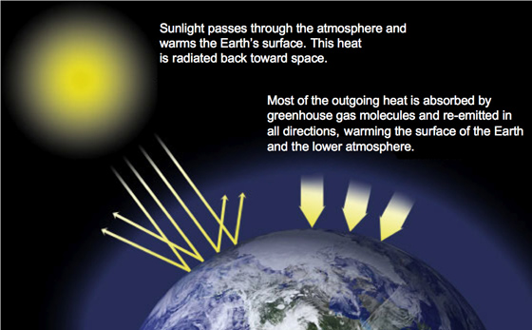
The Greenhouse Effect
A layer of greenhouse gases – primarily water vapor, and including much smaller amounts of carbon dioxide, methane and nitrous oxide – act as a thermal blanket for the Earth, absorbing heat and warming the surface to a life-supporting average of 59 degrees Fahrenheit (15 degrees Celsius). Source: http://climate.nasa.gov/causes
Notes:
During the discussion is an opportunity to bring up a term the students will probably have heard: the Greenhouse Effect. It’s important for students to realize that the Greenhouse Effect is what allows us to sustain life on Earth. Without the atmosphere insulating heat, the planet would be very cold and life might not be able to survive. However, the issue with global warming is that there are MORE greenhouse gases in the atmosphere now that are causing the earth to heat up faster than natural processes can regulate. The idea of balance is an important theme to reinforce throughout the lesson.
“Life on Earth depends on energy coming from the sun. About half the light reaching Earth's atmosphere passes through the air and clouds to the surface, where it is absorbed and then radiated upward in the form of infrared heat. About 90 percent of this heat is then absorbed by the greenhouse gases and radiated back toward the surface, which is warmed to a life-supporting average of 59 degrees Fahrenheit (15 degrees Celsius).” For more information, visit: http://climate.nasa.gov/causes

Slide 15
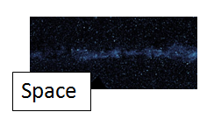
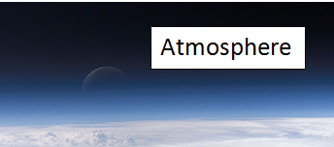
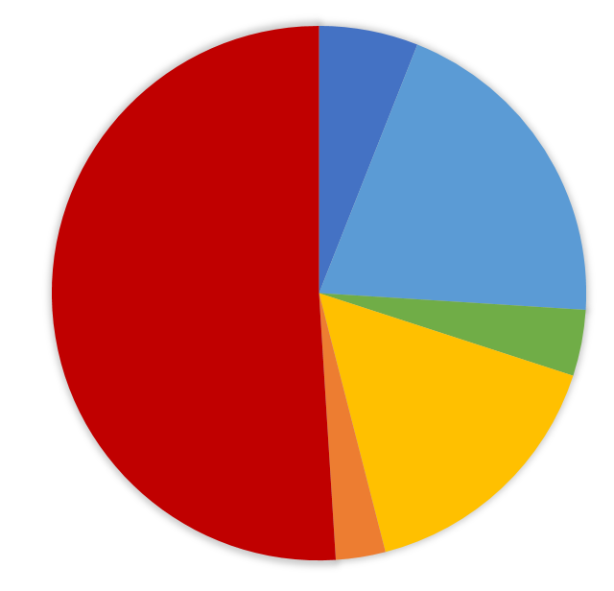
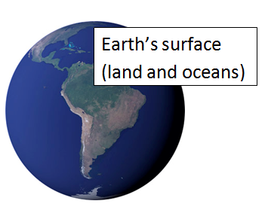
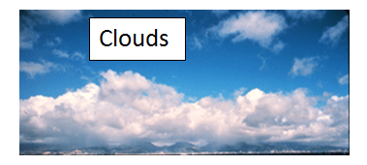
Acting out the Global Energy Budget
Reflected by atmosphere 6%
Reflected by clouds
20%
Reflected by Earth's surface 4%
Absorbed by land and oceans 51%
Absorbed by clouds
3%
Absorbed by atmosphere 16%
Notes:
Preparation: If possible, make a large poster-sized version of the pie chart (Figure A, available in both color and black and white), one per class. Trim the outside of the chart, leaving just a circle, before class to save time. Print Figures B-E. It may be useful to print them on cardstock and laminate them, and/or attached them to large craft sticks or dowels for students to hold.
Give four different students each one of the cards with the locations where energy can travel throughout the Earth’s system: Atmosphere, Clouds, Earth’s Surface and Space. Assign a fifth student to be the “Energy Messenger.”
The circle of the pie chart represents all the energy coming from the Sun. The teacher, or another student, cuts each segment of the chart, and the Energy Messenger takes it on its path. For example, the 6% reflected by the atmosphere would start at the “Sun,” be taken to the student holding the Atmosphere label to bounce off, and then be handed to the student holding the Space label.
The main idea is that students see a visualization of all the ways the energy travels, and note that while the energy gets used within the Earth’s systems, and may say there for some time, it all eventually ends up back out in space for a balanced energy budget.
Important points for discussion:
- When the 51% that gets absorbed by the surface (land and oceans) is reached would be a good time to discuss what happens to that energy in the Earth’s system, especially relating it to the water cycle and other needs of life on Earth (photosynthesis, etc.)
- The 4% that bounces off of the surface (as well as the absorption in the previous note) can easily be related to previous lab. Which surfaces on Earth absorb more? Which reflect more?
- The absorption and reflection of clouds can be discussed. What would happen if there were more cloud cover on the Earth? Less cloud cover?

Slide 16
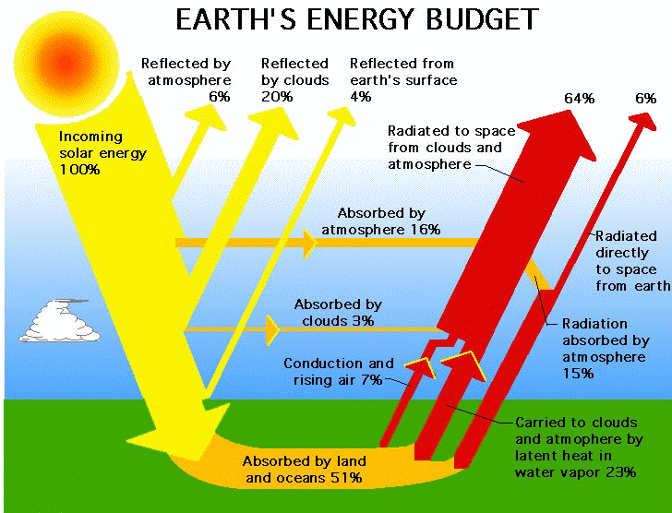
Global Energy Budget
Study the Earth's Energy Budget.
→What is absorbing and reflecting the Sun's energy?
→Where is most of the energy being absorbed?
→What carries a large percentage of heat back into the atmosphere?
Animated Energy Budget
http://earthguide.ucsd.edu/earthguide/diagrams/energybalance/
Notes:
What is absorbing and reflecting the Sun’s energy? Clouds, atmosphere and Earth’s surface (land and oceans) all do both, but in different percentages.
Where is most of the energy being absorbed? The greatest single place energy is absorbed is into the land and oceans, Earth’s surface (51%)
What carries a large percentage of heat back into the atmosphere? Latent heat in water vapor (the energy carried with the water when it evaporates) carries 23% of the energy back into the atmosphere. Radiation from Earth’s surface is also absorbed into the atmosphere, heating it.
Image source: http://science-edu.larc.nasa.gov/EDDOCS/images/Erb/components2.gif
For Earth’s radiation budget facts: http://science-edu.larc.nasa.gov/EDDOCS/radiation_facts.html

Slide 17
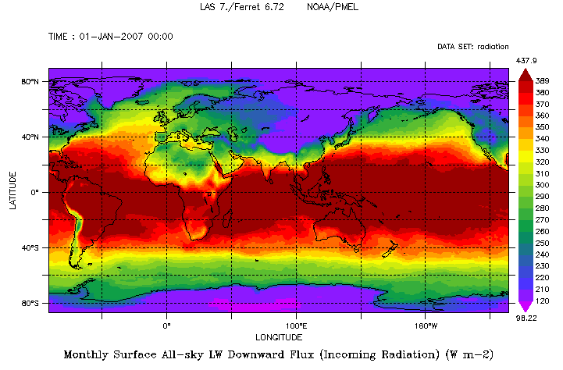
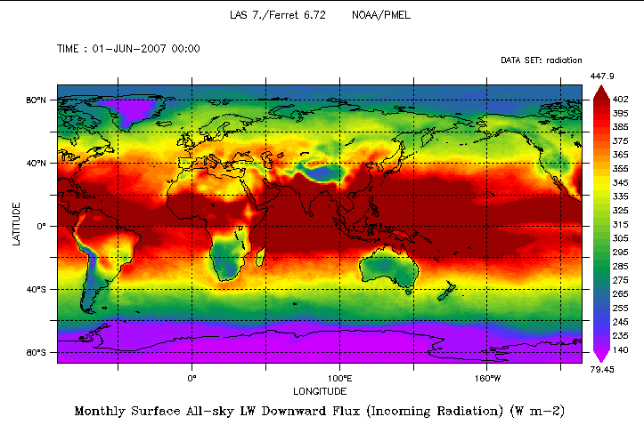
Incoming Radiation – January versus June
Notes:
Questions to ask students:
What differences do you notice between these two maps? Answers may vary. Students may note that the part of the world with the high incoming radiation shifts during the different seasons. They may notice that the poles get less radiation (shown in blue and purple).
What part of Earth tends to receive the most solar radiation (before we even consider the reflection of the surfaces or clouds)? Why is that important in the Earth’s energy budget? Near the equator tends to receive more radiation. That means there is more energy to “spend” in that region.
Which parts of Earth tend to receive little solar radiation? Why is that important for the Earth’s energy budget? Near the poles tends to receive less radiation, and it varies by season. That means there is less energy to “spend” in those regions.
Maps retrieved from https://mynasadata.larc.nasa.gov/las/getUI.do

Slide 18
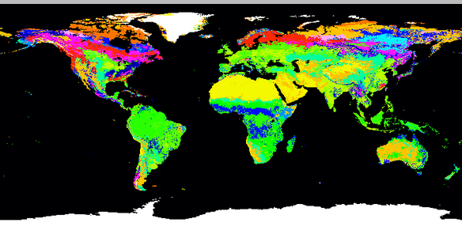
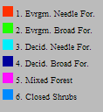
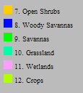
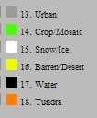
Earth’s Land Cover
Notes:
Questions to ask students:
Do you see any interesting patterns in the data? Answers may vary. You might point out the desert and ice areas, as well as the variety of forests in various areas.
Where do you notice permanent snow and ice? What would you expect the reflected radiation from that location to be, high or low? Antarctica, Greenland. You would expect a lot of radiation to be reflected from the ice.
What other land cover types might reflect a lot of solar radiation? What types might absorb a lot of solar radiation? Deserts and barren areas reflect a lot of solar radiation. Oceans and forests absorb a lot of radation.
To zoom in to get more detailed data on a particular location (with different color-coding) go to http://www-surf.larc.nasa.gov/surf/pages/sce_type.html

Slide 19
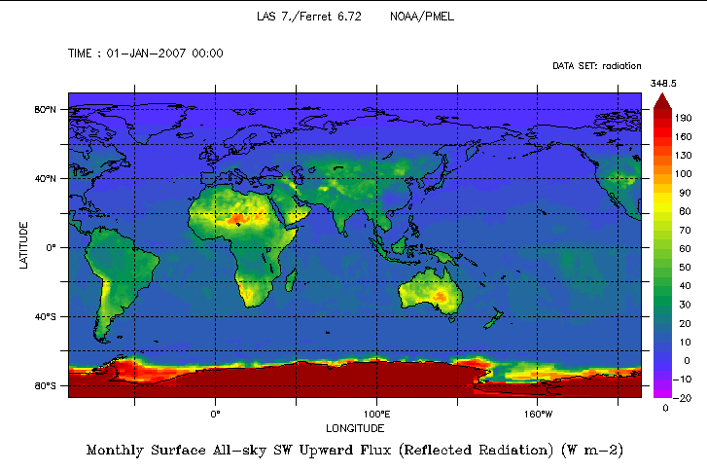
Reflected Radiation - January
Notes:
Questions to ask students:
Which areas seem to have reflected the most radiation? Does that match with what you predicted from the land cover types from the previous image? Antarctica is reflecting a lot of radiation (due to the snow and ice cover). The Sahara desert and parts of Australia also show reflection, as do the Andes mountains.
Why is Antarctica reflecting so much radiation? What about the areas in Africa and Australia? Ice/snow and desert reflect a lot of radiation because they have a high albedo.
Greenland also had lots of ice, why does it not show any reflection? Hint: Note that the date of this data is January. Due to the Earth’s tilt, near the North Pole receives fewer hours of daylight during the winter months.
Maps retrieved from https://mynasadata.larc.nasa.gov/las/getUI.do

Slide 20
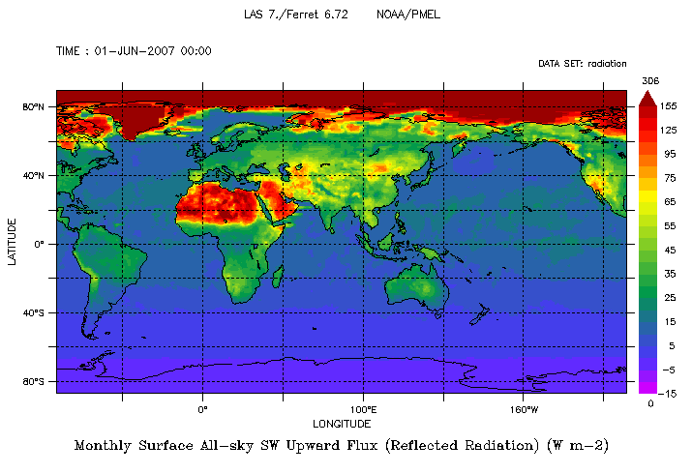
Reflected Radiation - June
Notes:
Questions to ask students:
1. What do you notice different in this picture? How is what you see now related to the land cover and the time of year (now June)? Now you can see that the Sahara is reflecting a lot of radiation, as is the Arabian peninsula. Greenland and the Arctic are now receiving daylight since it is the summer, and you see the corresponding reflection in red.

Slide 21
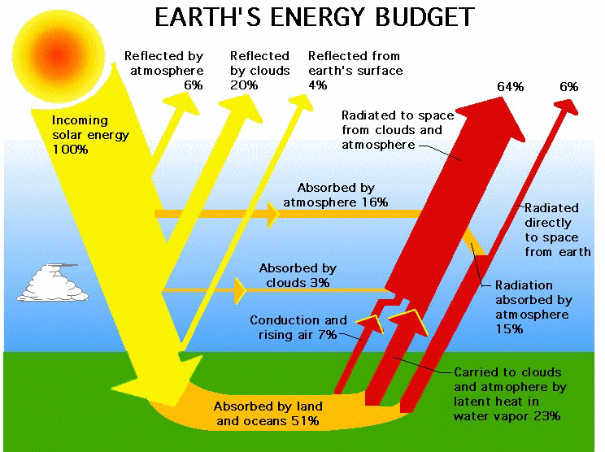
Summarizer
Describe what the Global Energy Budget is and how it works.
What would happen if the surface of Earth changed to be more or less reflective? If there were more or less clouds all the time? How are the oceans and other water important to the Global Energy Budget?
Notes:
Answers may vary: Sample answer “The global energy budget is how the Earth “spends” its energy, basically where and how it gets absorbed for use in the Earth system, radiated into the atmosphere or back into space, or reflected. If the Earth’s surfaces becomes more reflective (surfaces such as ice, snow or desert), less energy will be absorbed, making the temperature cooler. If the Earth’s surface becomes less reflective (more oceans and forests), more energy will be absorbed, making the temperature warmer. Clouds tend to reflect energy back into space, so more clouds would tend to reduce the temperature, while fewer clouds could increase the temperatures. Oceans absorb a lot of heat, so they are a key part of the global energy budget. When ice melts and reveals the ocean (or land) underneath, that changes the way energy is absorbed and affects the budget.”

Slide 22
Extension Activities

Slide 23
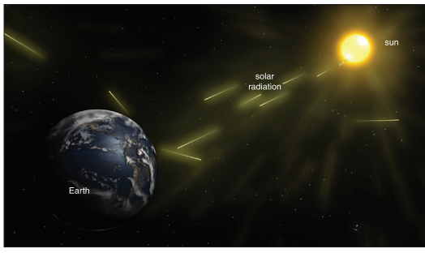
Aqua CERES: Tracking Earth’s Heat Balance
Source: NASA
Notes:
Linked from the image, the video discusses similar themes as the video on slide 12, but with a few more details added (duration: 3:25). However, it is not geared specifically toward students. For more about CERES, see http://ceres.larc.nasa.gov/

Slide 24
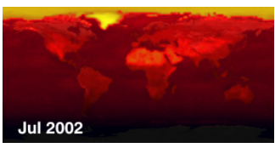
Average Clear-Sky Outgoing Radiation
Source: NASA/Goddard Space Flight Center Conceptual Image Lab
Notes:
This animation and the one on the next slide relate to the maps on slides 19 and 20, but shows the progression through the months for several years. It may be helpful for students to be able to see more continuous data, but you may need to use your web browser to zoom in to make the animation more easily visible.
“This animation shows the monthly average clear-sky outgoing shortwave radiation from July, 2002 through June, 2004 as measured by the CERES instrument. This is the sunlight that is directly reflected back into space by ice, desert, and other physical areas on the Earth when the sky is cloud-free. The ice sheets can be clearly seen to reflect the most sunlight, with desert areas next. Oceans absorb the most sunlight, more than the vegetated land areas such as the tropical rain forest and temperate forests and plains.” For more information go to: http://svs.gsfc.nasa.gov/goto?3096

Slide 25
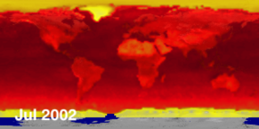
Average Clear-Sky Albedo Animation
Source: NASA/Goddard Space Flight Center Conceptual Image Lab
Notes:
“This animation shows the monthly average clear-sky albedo from July, 2002 through June, 2004 as measured by the CERES instrument. This is the fraction of the incoming solar radiation that is reflected back into space by regions of the Earth on cloud-free days. The regions of highest albedo are regions of snow and ice, followed by desert regions. Oceans have the lowest albedo, and reflect very little of the incoming solar radiation. It is not possible to measure the albedo during the winter months at the poles, since there is no incoming solar radiation during these times.” For more information go to: http://svs.gsfc.nasa.gov/goto?3089

Slide 26
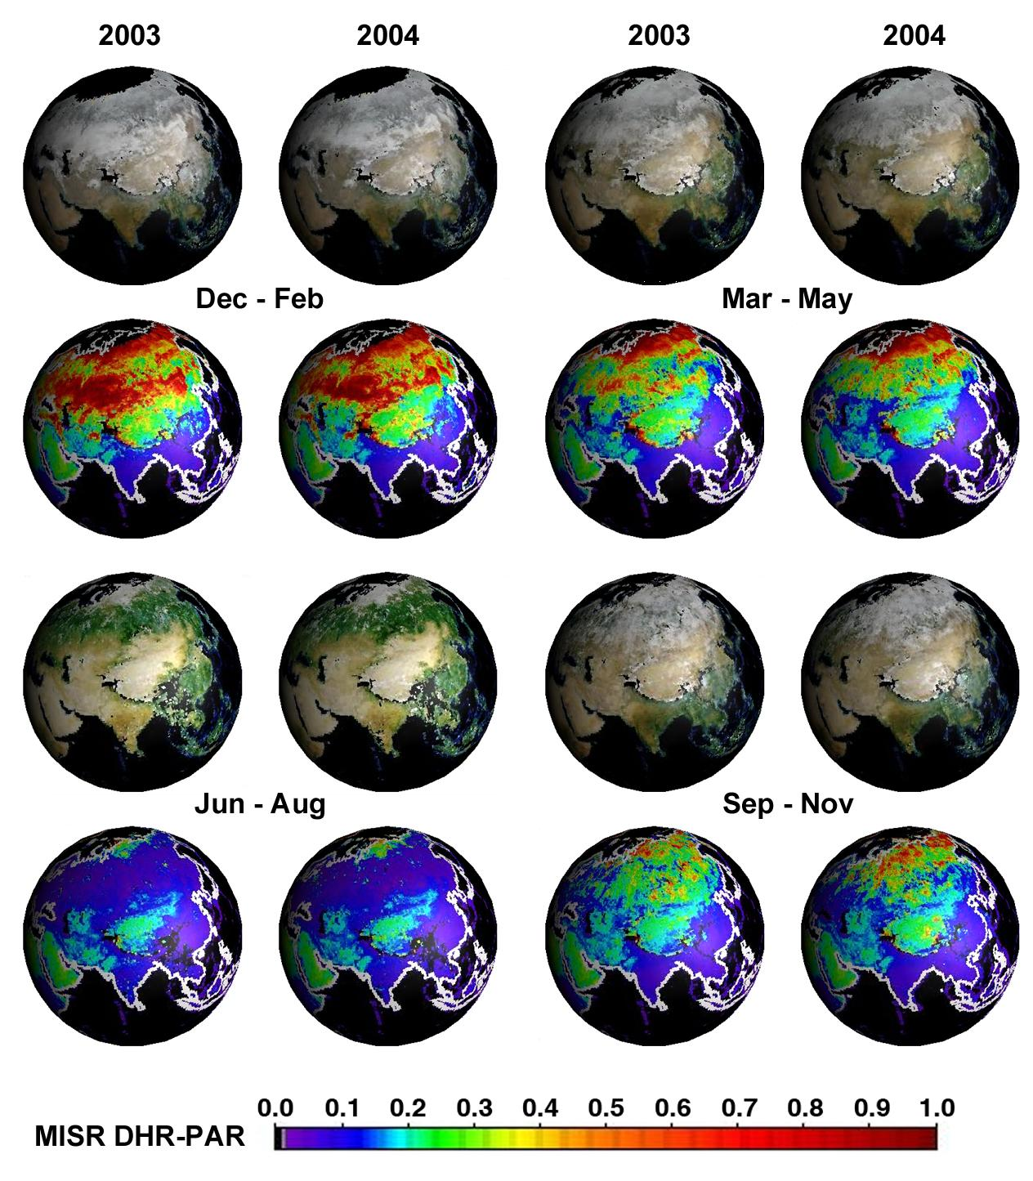
Seasonal Changes in Earth’s Surface Albedo
Notes:
This is simply another way to look at the seasonal patterns in albedo. Students should be able to notice the increased reflectivity in the northern winter months, and also see that there is some variation year to year.
The first and third lines of this image are a combination of wavelengths to create a natural color reflectance image. The second and fourth lines use wavelengths that are used in photosynthesis and therefore absorbed by vegetation. The scale shows the albedo based on the reflection of these wavelengths. Remember that albedo ranges between zero (all sunlight is absorbed and none is reflected) up to one (all sunlight is reflected, none is absorbed.) Fresh snow has an albedo close to one for visible light, while deep clean ocean water has an albedo that is close to zero. Areas in black are where data could not be derived.
For more detailed information on this diagram, go to http://photojournal.jpl.nasa.gov/catalog/PIA0437 8

Slide 27
Differentiation and Re-teaching

Slide 28
Word Splash
reflection
Notes:
You might bring in examples of objects that are reflective - for example foil, or a reflective shade for a car windshield. For the latter, you could ask students why you would want to use such a thing, and if they have any experience of using them in a vehicle.

Slide 29
Word Splash
radiation
Notes:
Shining a light bulb on students' hands is a good way to show radiation - they don't need to touch the bulb to feel the heat. This can then be related to the Sun's energy travelling through the vacuum of space.

Slide 30
Word Splash
absorption
Notes:
For absorption, you could refer back to the car example, and if students' have experienced different cars or car upholstery having a different temperature when exposed to the Sun. Although it's not energy precisely, a sponge is also a good visual example of absorption to use, especially for English Language Learners.

Slide 31
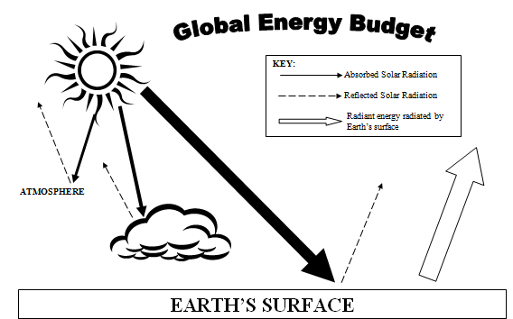
Global Energy Budget
Some absorbed heat is radiated back into atm. *a large % as latent heat in water vapor
20% of sunlight reflected by clouds and 3% is absorbed
4% reflected by surface and back into atmosphere
16% is absorbed by gases and dust in the air and 6% reflected
51% of energy absorbed by land and water
Notes:
This diagram is designed to be used interactively on a smart board - drag each statement to the corresponding arrows/areas. Being able to move around the phrases may help some students get a better grasp of the energy budget. See the end of the student capture sheet for a worksheet for students to record where the various percentages belong.

Slide 32
Global Energy Budget
16% is absorbed by gases and dust in the air and 6% reflected
Some absorbed heat is radiated back into atm. *a large % as latent heat in water vapor
51% of energy absorbed by land and water
20% of sunlight reflected by clouds and 3% is absorbed
4% reflected by surface and back into atmosphere
Notes:
Key to where labels should go.

