Slide 1
Weather Hazards in Remote Oceanic Operations
Nathan Polderman
NASA GPM-ACCP Transportation and Logistics Workshop
November 4th, 2020

Slide 2
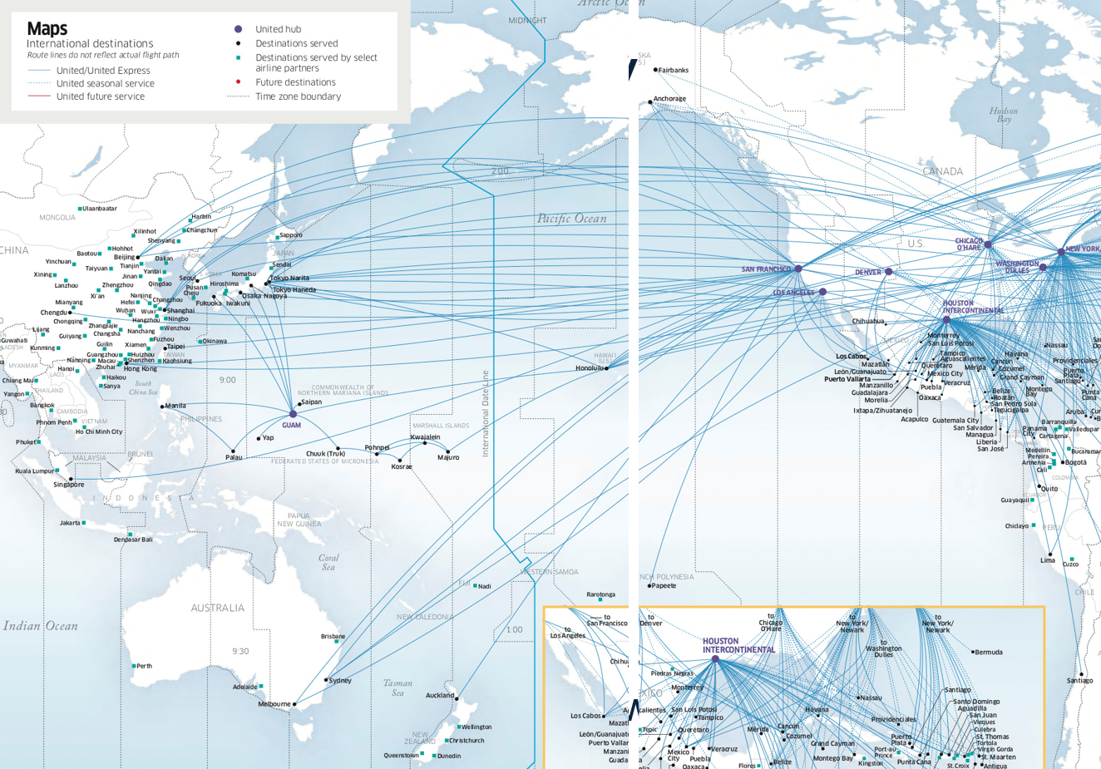
United is the largest US carrier serving Asia-Pacific destinations
Long-haul trans-oceanic routes crossing the ITCZ

Slide 3
Hazards of deep tropical convection
PIREP from B747-8 @ FL 350
“Intermittent IMC to 330 then IMC up to 370. TAT approximately zero (0). Winds 330/19, light to mod turbulence, no icing.”
“TAT indicator wrong. Rain on windscreen at 370 (impossible)…suspect ice crystals due to the sound.”
“Heavy returns 5 to 7000 feet below us. Saw tops above 41K before going IMC. No returns at our higher altitude.”
“…Appears Engine 1 rolled back briefly, then recovered.”
Anomalously high ice water contents (>1 g/m³) at cruise altitudes
TAT anomalies
Engine flameouts, surges, high vibrations, or compressor damage
Lack of cockpit radar returns, sound of ‘icy rain’ hitting windscreen
Not easily detectable by traditional geostationary satellites
Notes:
HIWC – not well understood, difficult to detect using traditional tools
HIWC threat mitigated on GENx engines through new ICI software

Slide 4
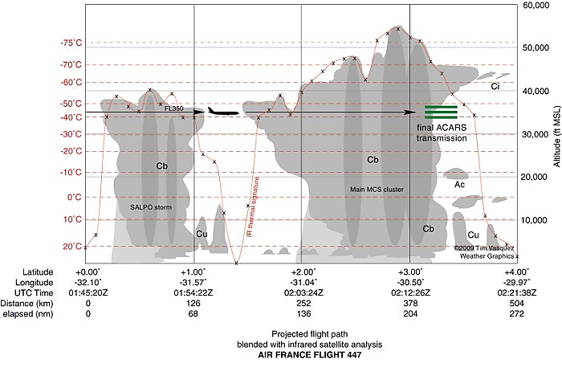
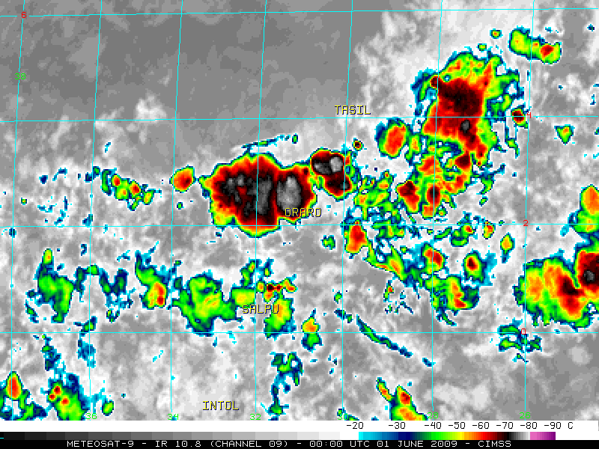
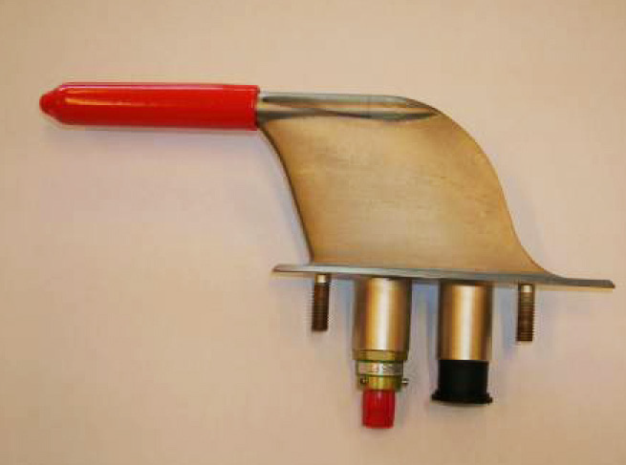
Hazards of deep tropical convection
© 2009, Tim Vasquez
Air France 447 – June 1st, 2009
Notes:
Briefly review the event:
Ice buildup inside pitot tubes – TAT anomaly, erroneous indicated airspeed readings

Slide 5
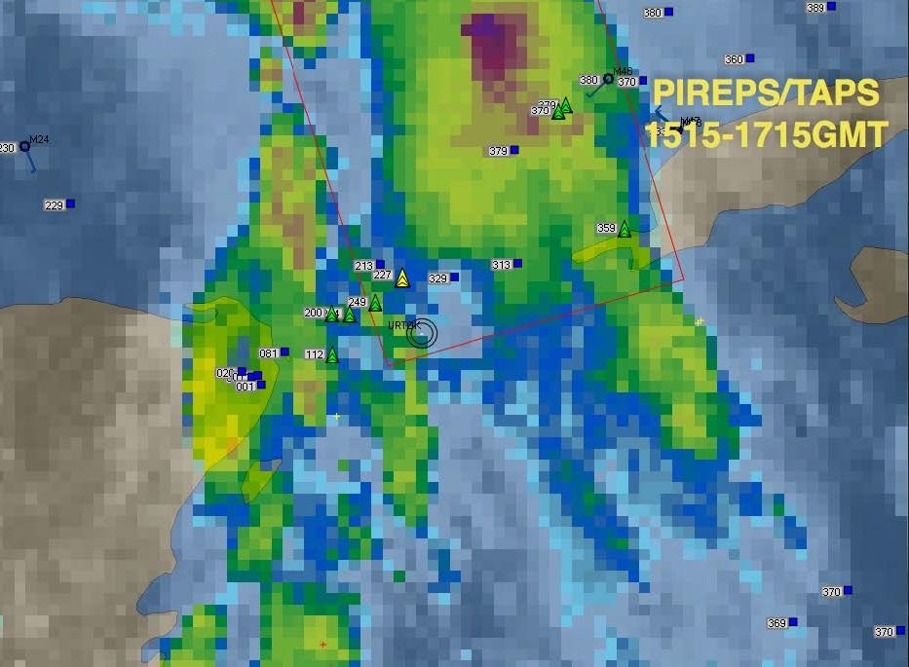
Hazards of deep tropical convection
“In June 2017, a Boeing 737 flight experienced unexpected severe turbulence at FL360 in the vicinity of the Yucatan…medical personnel met the aircraft at the gate to respond to customer and fight attendant injuries. Eight customers and one flight attendant were transported to the hospital for treatment of minor injuries and released. An additional 6-8 customers were treated plane-side for minor injuries and released.”
Convectively-induced turbulence
“While operating through the gap, the first officer stated conditions were IMC in very thin cirrus with no radar returns. About halfway through the opening the flight experienced severe turbulence. The autopilot tripped off and a bank angle warning annunciated with a roll to the right. There was also a stall buffet…Altitude loss reported as 400 feet. The pilots stated the turbulence lasted only a few seconds.”
Screenshot from Flight Dispatcher graphical flight following tool
Notes:
Common theme: weak to no flight deck radar returns
Limitations of flight deck radar systems – requires large droplets which may not be detected in rapidly developing Cb’s from below

Slide 6
Trans-oceanic operational challenges
Long-haul flights operating at aircraft range and performance limits
Data-sparse, radar-less, unforgiving environment
Limitations of traditional geostationary satellite imagery; resolution of weather graphics available in primary tools
Limitations of flight deck radar systems
Tropical convection typically lacks frequent lightning to aid detection
Difficulty of requesting and receiving enroute deviations or re-routes
How will the next generation of satellites help us ‘see’ inside clouds and improve our understanding of 4-D convective weather threats with sufficient lead time to mitigate risks?
Notes:
Mention FAA ROMIO
Talk about the difficulties and slow pace of R2O efforts in aviation

