Slide 1
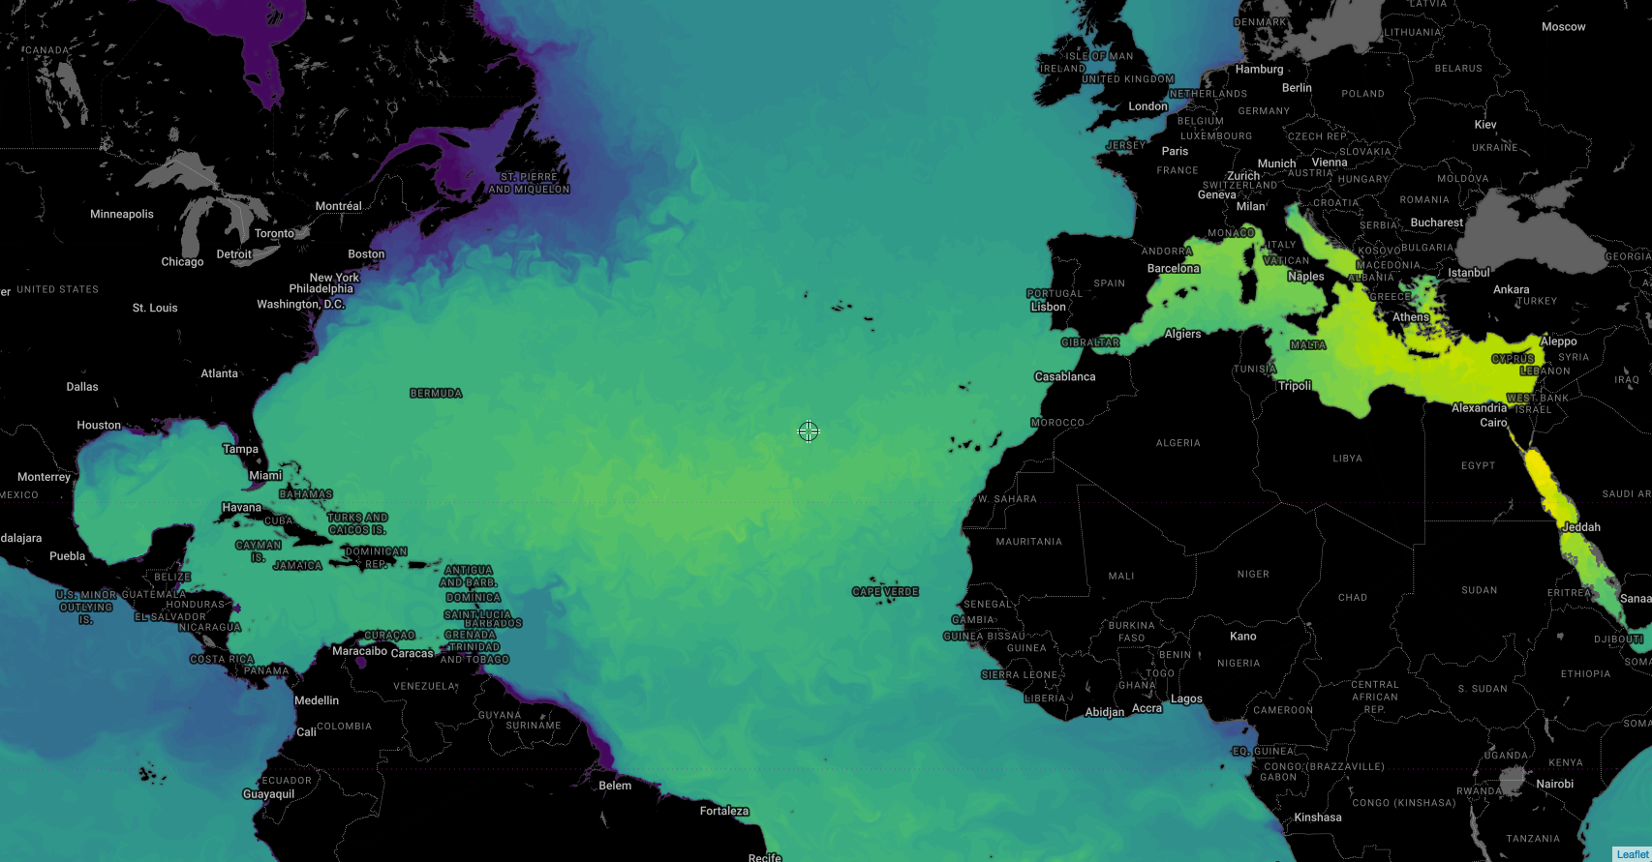
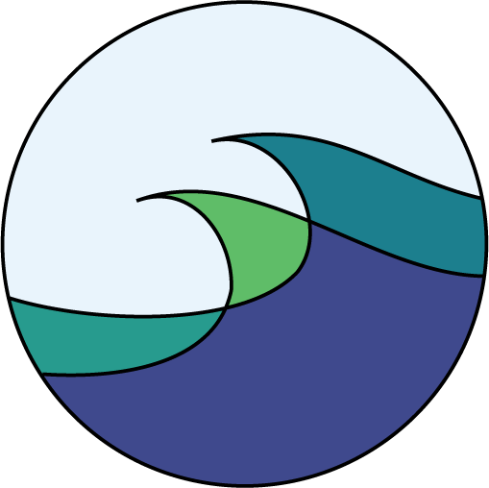
NASA Satellite Data Use by Fathom Science
Presenter:
Jennifer Warrillow
Notes:
Good afternoon. Thanks to NASA for the opportunity to be part of this workshop and for supplying such useful data so reliably and so freely. I’ll start with a description of Fathom Science, then describe what satellite data we use and how.

Slide 2
About Fathom Science
Science & technology company providing high-resolution, high-fidelity Marine Environment Analytics
Site-specific marine environment information in 4D (x, y, z, time), from the top of atmosphere to bottom of ocean
sea surface temp, sea surface height, salinity, density, etc.
Blue economy
Products: Data, maps, analyses, forecasts, hindcasts, etc.
In-house expertise in Metocean systems
$12M+ federal and state R&D investment
100+ peer-reviewed journal publications
Spinoff from NC State University
Ruoying “Roy” He
Founder & President
rhe@fathomscience.com
Jennifer Warrillow
VP of Operations
jwarrillow@fathomscience.com
Joseph B. Zambon
VP of R&D
jbzambon@fathomscience.com
Michael Muglia
VP of Product Development
mmuglia@fathomscience.com
Notes:
Fathom’s founder is Dr. Roy He, who will join the panel discussion at the end of this session. I’m Jennifer Warrillow, VP of Operations. Our team is rounded out by Drs. Joe Zambon and Mike Muglia, who specialize in metocean prediction, computer modeling, and ocean observation. Fathom provides high-resolution, high-fidelity Marine Environment Analytics, and by that we mean site-specific marine environment information such as SST, SSH, salinity, & density in 4D (x, y, z, time), from the top of atmosphere to bottom of ocean. We’re part of the blue economy, refers to economic activities that are based in and which are actively good for the ocean. Our products deliver information in whatever form our clients need, including maps, data, analyses, forecasts, and hindcasts. Our strength is our expertise in metocean science – which is the union of meteorology and oceanography - metocean. We develop, update, and run our numerical models in-house. Our research has been funded by over $12M in federal & state investment, and our scientists have over 100 publications. Fathom is a spinoff company from North Carolina State University.

Slide 3
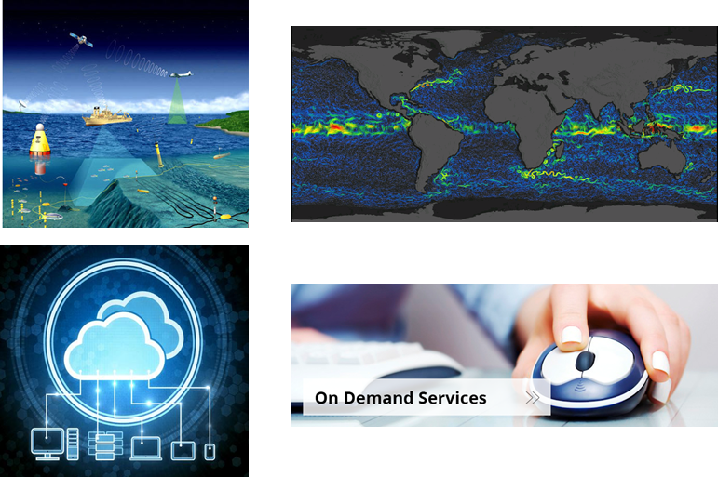
Fathom Science’s Technology
cloud Computing
coupled Big data
modeling analytics
Real-time data acquisition, including satellite data
State-of-the-art coupled marine environment prediction modeling
High-resolution, high-fidelity Metocean information
and value-added products for on-demand services
Cloud computing & Big Data analytics
Notes:
Fathom’s Proprietary system ingests real-time observations, including satellite data, into our coupled marine environment model. Specifically, we couple ocean, atmosphere, and wave model components so that as the models run, they pass information to each other. This is critical for accurate understanding of the marine environment. A hurricane is as much an ocean event as it is an atmospheric event. Cloud computing helps us stay agile in scaling up and down to meet computation demands. The result is our metocean information served in the format clients need.

Slide 4
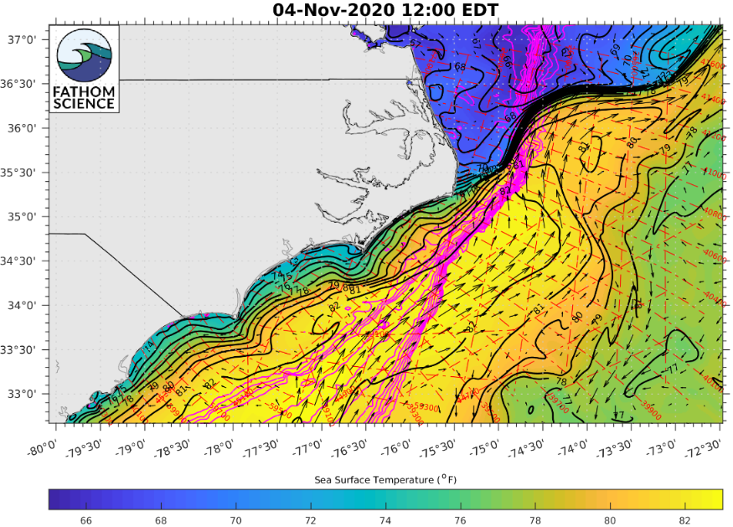
Fathom Science Coupled Numerical Modeling
Our ocean-atmosphere-wave coupled modeling system
Accurate and high-resolution, with ultra-high res nesting
Includes river-ocean interfaces
Covers U.S. coastal oceans, Gulf of Mx, Caribbean -> global ocean
Highly extensible to different environments, regions, and configurations
Example: FishCast sea surface temp, currents, and bathymetry off the Outer Banks, NC
Notes:
Fathom’s coupled ocean-atmosphere-wave modeling system is accurate and high resolution over the whole domain, with ultra-high resolution nesting possible for any specific subdomain. Ultra-hi res is more computationally expensive, so we don’t run it over the whole domain on an operational basis. The system includes river-ocean interfaces to capture coastal flooding events. The domain we focus on currently is the US east coastal ocean, G of Mx, and Caribbean, and have plans to expand to the global ocean. One of the features of this system is that it is extensible to different environments, regions, and configurations. On the right is a product sample: a surface map of the coastal ocean off NC, where color shading shows SST, black arrows are current vectors, and magenta lines are bathymetry.

Slide 5
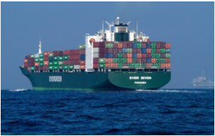
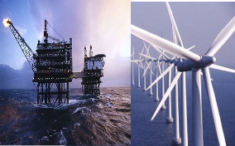
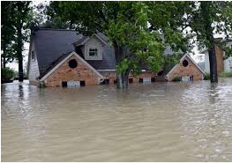
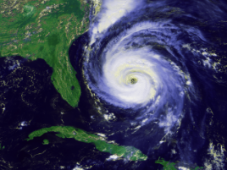
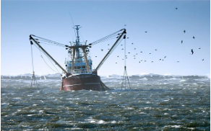
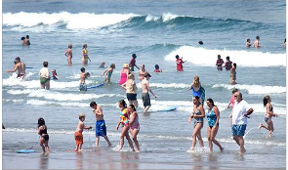
Sectors Fathom Science Serves
Ship Routing
Energy
Risk Assessment
Offshore wind, oil & gas, marine hydrokinetic
Shipping, cruise lines, military
Insurance, business, local govt.
Severe Weather
Fishing
Tourism/ Water Quality
Govt., military, weather companies, individuals
Local govt., tourism boards, resorts
Commercial, recreational, sport fishers
Notes:
Our platform technology allows us to serve multiple sectors. We’re focusing on these sectors as present. In the ship routing sector, examples of clients include shipping companies, cruise lines, and the military. In the energy sector, we can serve offshore wind, oil, and gas companies, as well as marine hydrokinetic energy. In the Risk Assessment sector, insurance companies, businesses, and local govts can benefit from our marine environment analytics. For severe weather prediction, we can help govts, military, weather companies, and individuals be prepared. We serve commercial, recreational, and sport fishers currently. And in the tourism and water quality area, examples of clients include local govts, tourism boards, and resorts.

Slide 6
Fathom’s Use of Satellite Data
Mission | Data Fathom uses
GPM | Precip, clouds
JASON 1 - 3 | Sea surface height (SSH) / altimetry
MODIS | Sea surface temp (SST), ocean color
AVHRR/VIIR | SST
MUR-SST | SST
GOES-16 | Water vapor
Satellite data used to
constrain models: used as model input to keep modeled values close to observations during model runs
validate models: used to compare model output to observations to assess model accuracy
Looking forward to using
SWOT: Very high resolution sea surface altimetry. Essential for resolving mesoscale ocean circulation features for greater accuracy.
ICEsat data: For differences in water levels and perhaps individual ocean wave crests.
Notes:
Here are specific examples of satellite data that Fathom uses. Apologies to NASA that some of these are NOAA satellites, but this illustrates the types of data we need. We use Satellite data in two ways: first, to constrain the model, where the data is used as input to keep modeled values close to observational values during model runs. Second, we use satellite data to validate model output: by comparing model results to observational data, model accuracy can be assessed. We’re looking forward to using SWOT and Icesat mission data, especially for the very high resolution sea surface altimetry that is key to resolving mesoscale ocean circulation features such as eddies.

Slide 7
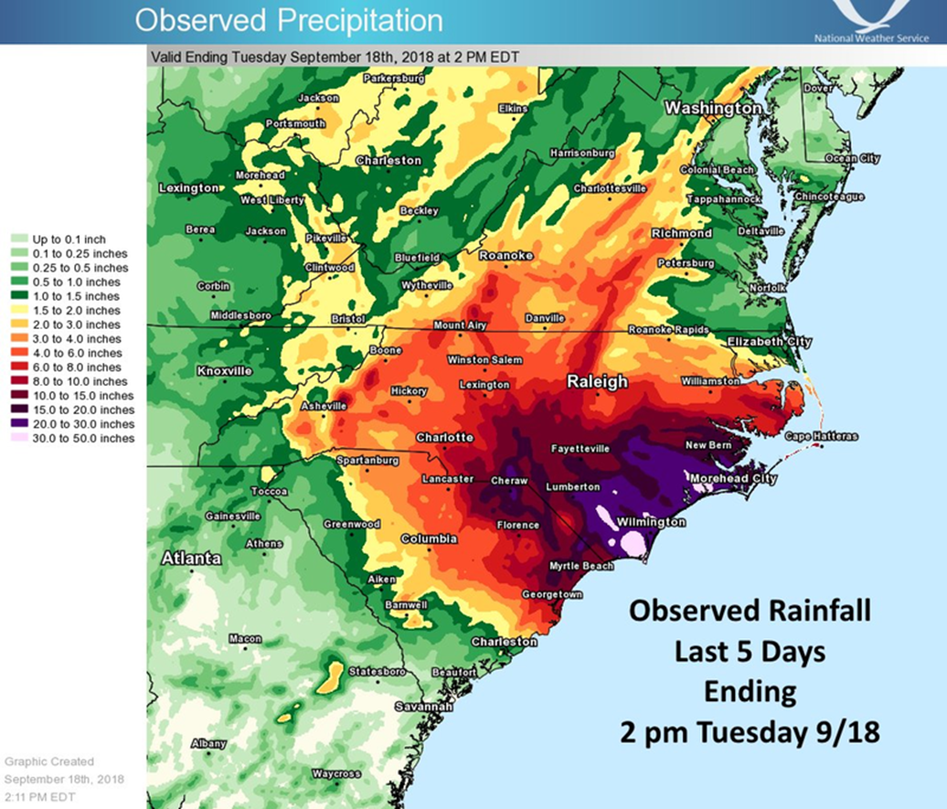
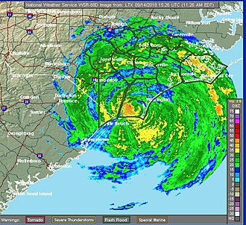
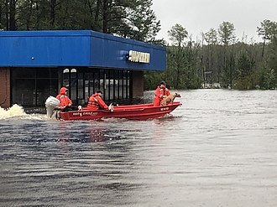
Fathom’s Use of Satellite Data: Example
GPM data: used to model and forecast compound flooding from strong storms
Compound flooding = local precipitation + storm surge + increased river runoff
Hurricane Florence, Sept. 2018
Rivers
Precip
Storm surge
Notes:
Here’s a specific example of the utility to Fathom of GPM precipitation and cloud data. Prediction of compound flooding requires very accurate, high-resolution satellite data. * Fathom used GPM data to model the arrival of Hurricane Florence in NC in Sept. 2018. Compound flooding is a combination of local precipitation plus storm surge plus increased river runoff due to precipitation in the watershed. *The area around Wilmington, NC received over half its annual rainfall in 5 days,* leading to major compound flooding. Forecasts of events like this are of critical importance to local governments and other users to minimize the risk to life and property.

Slide 8
Fathom’s Wishlist for NASA Satellite Data
Maintain existing infrastructure and data streams
As high resolution SSH, SST, and ocean color as possible
sub-km scale
Notes:
Fathom’s greatest wish for NASA satellite data * is to maintain the existing infrastructure and data streams so we can continue to serve decision makers and other end users. We also would love to have as high resolution as possible data for ssh, sst, and ocean color, on the sub-km scale.

Slide 9
Thank you
Roy He
Founder & President
rhe@fathomscience.com
Jennifer Warrillow
VP of Operations
jwarrillow@fathomscience.com
http://FathomScience.com
Notes:
On behalf of the FS team, thank you. And if Fathom’s metocean analytics can be of use to you, please contact us.

