Slide 1
Examples and Comments on use of GPM in Flood and Landslide Hazard Estimation
Robert Adler
Earth System Science Interdisciplinary Center
University of Maryland, College Park, MD

Slide 2
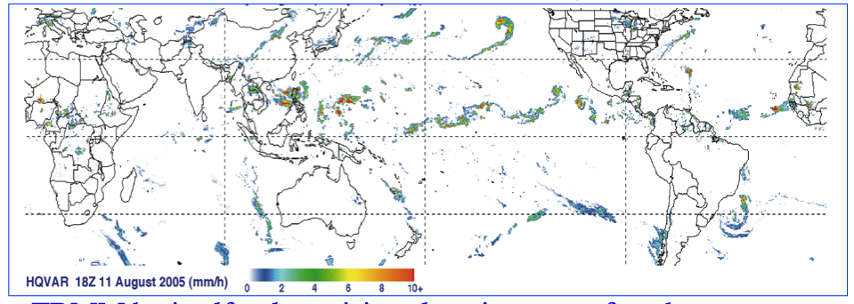
Global Flood Calculations Using Satellite Rainfall and Hydrological Model
Global Flood Monitoring System (GFMS)
http://flood.umd.edu/
Rainfall input from satellite information---Currently using TRMM + other satellites—TRMM Multi-satellite Precipitation Analysis [TMPA/3B42])
IMERG GPM product will start next year—automatic re-processing to beginning of TRMM era (1998) for consistent long record (Yes!!)
GPM will immediately address some questions, but others may remain:
Accuracy—in general, for shallow orographic systems, over-land artifacts
Timeliness (latency)
Error estimates

Slide 3
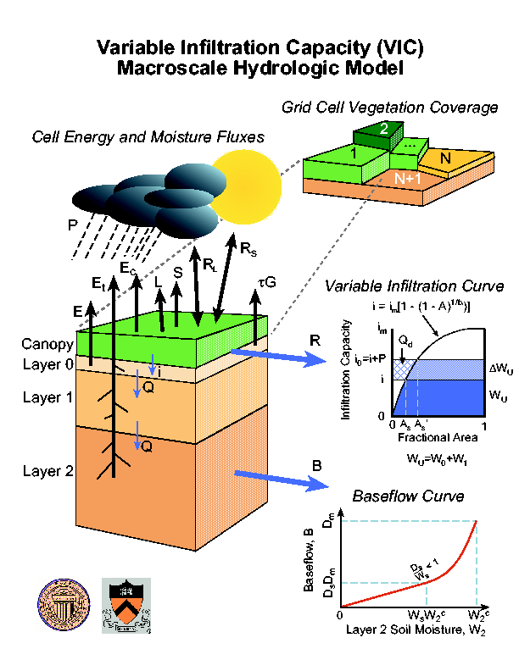
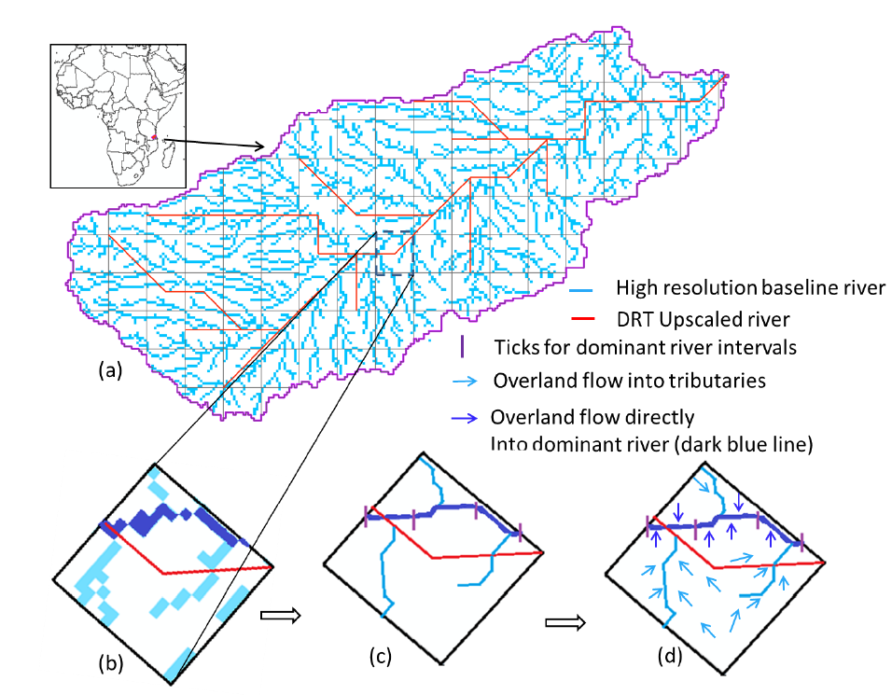
Dominant river tracing-Routing Integrated with VIC Environment (DRIVE) model
(Wu et al., 2011, 2012, 2013 Water Resources Research)
VIC
DRTR-Dominant River Tracing (DRT) based Routing
Coupled
University of Washington
University of Maryland
System is running quasi-globally every three hours at 1/8th degree, and routing is also running at 1km resolution.

Slide 4
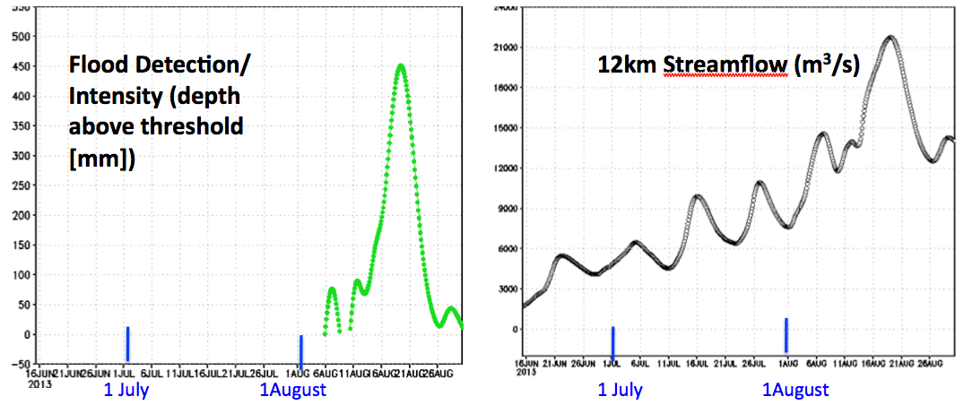
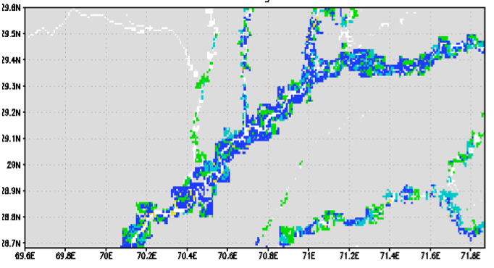
Global Flood Monitoring System (GFMS)
Global Real-time Flood Calculations Using Satellite Rainfall and Hydrological Model
http://flood.umd.edu/
TRMM calibrating rainfall from other satellites as forerunner to GPM
TRMM/GPM rainfall into land surface and routing models for water depth and stream flow calculations compared to flood thresholds
Indus River basin Aug. 20 2013
Global
Flood Detection
Experimental Inundation Mapping at 1 km resolution
Time Histories at a Point

Slide 5
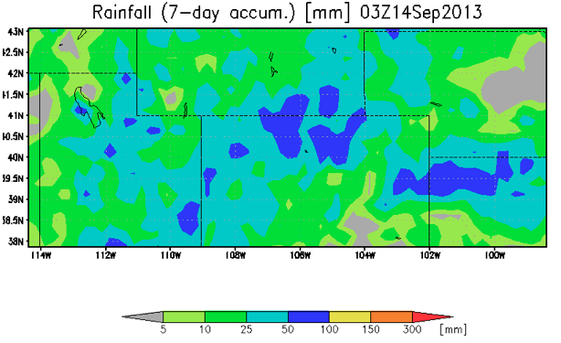
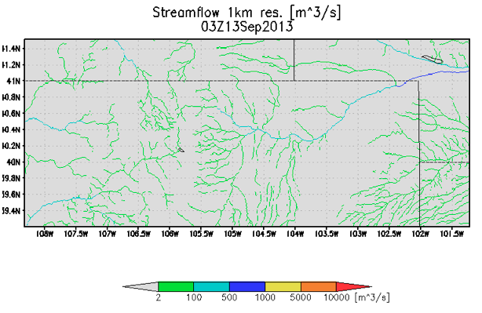
Colorado Floods Not Identified by GFMS
Satellite real-time rainfall estimation greatly underestimated actual rainfall with satellite estimates of ~ 75 mm (~ 3 “, see fig. to left) vs. reports of 9” in raingauges. This is reflected in streamflow estimates in our system that went up, but not significantly along front range (although affected streams are resolved in 1 km results (see image to left). Other earlier events had higher streamflows in our system.
This is not a new problem, but a continuing one when the rainfall event is a shallow orographic system, as this was. The satellite precipitation community needs to work on this and some investigators are.

Slide 6
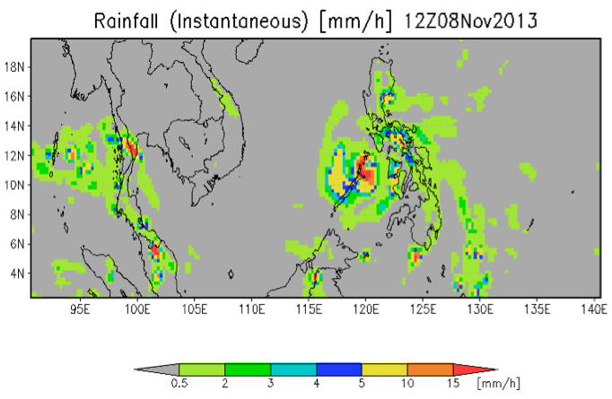
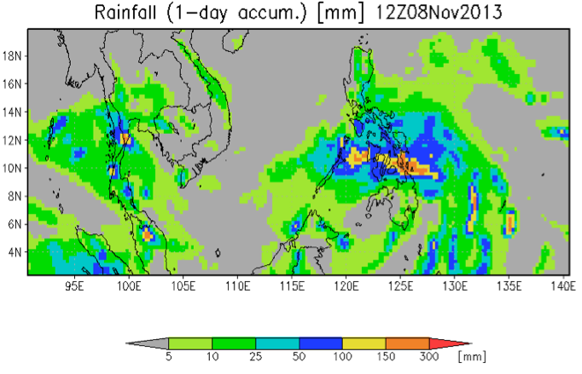
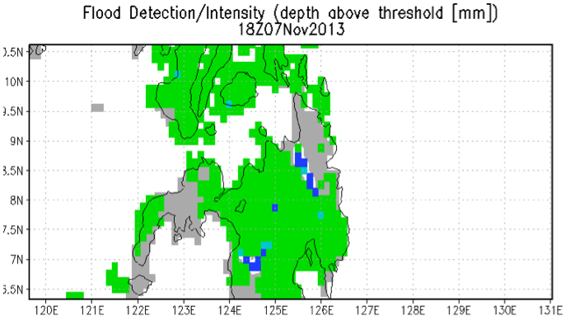
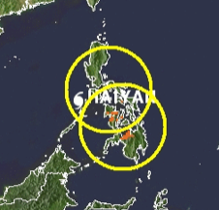
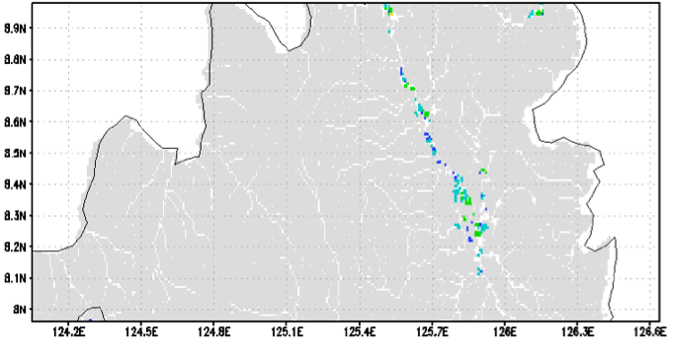
Typhoon Haiyan in Philippines: Heavy Rain, Some Flooding, Landslides
Typhoon Hiyan produced rainfall up to about 300 mm, although most damage was due to very high winds and surge.
Some flooding estimated from Haiyan and previous rainfall along with landslides.
Estimated Landslide Areas
Experimental calculated inundation map at 1 km
flood.umd.edu
Adler/Wu
U. of Maryland

Slide 7
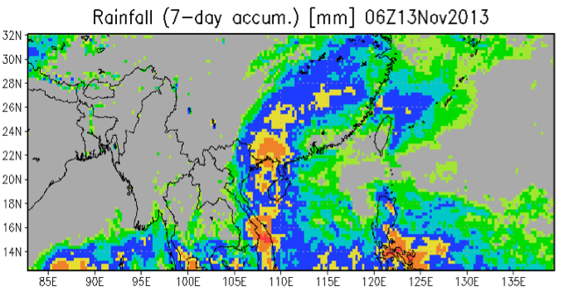
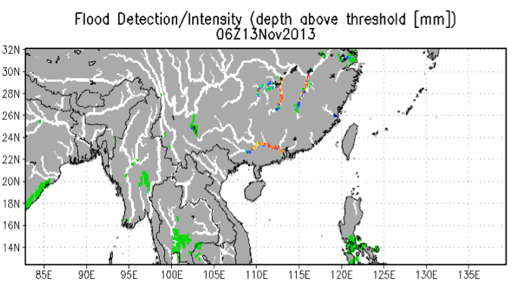
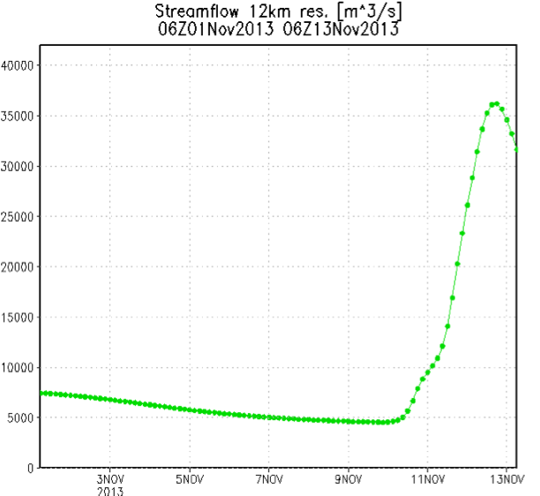
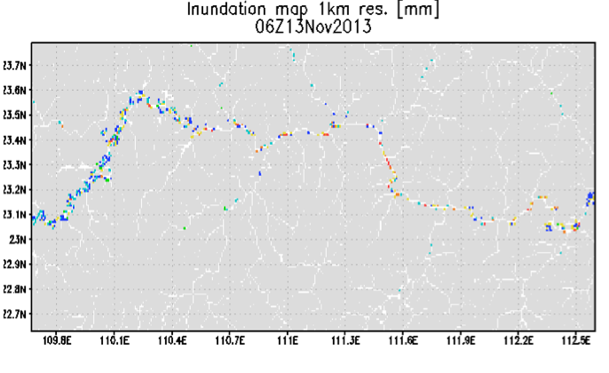
Today in South China
Experimental calculated inundation map at 1 km
flood.umd.edu
Adler/Wu
U. of Maryland

Slide 8
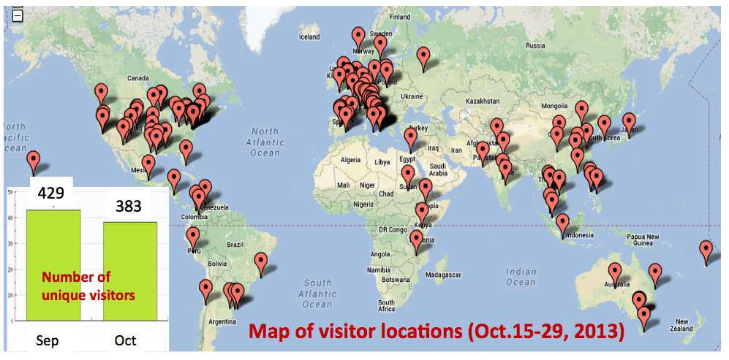
Recent Visitors/Users of GFMS website ( flood.umd.edu )

Slide 9
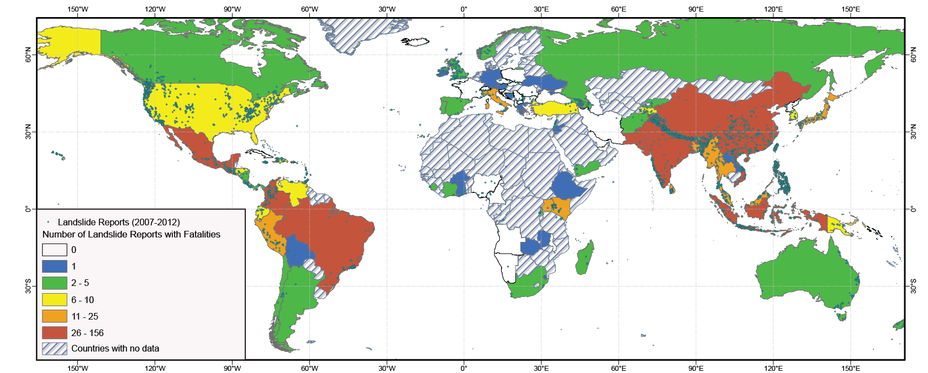
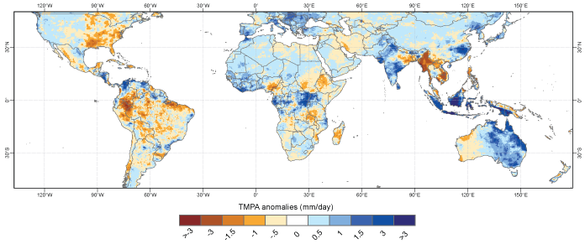
Evaluating the Co-occurrence of landslide reports and TRMM rainfall
Dalia Kirschbaum, NASA GSFC
95% of all landslides triggered by rainfall
Areas that experience the worst impacts do not have adequate ground-based instruments to identify conditions that may trigger landslides
Studies have shown how TRMM and GPM data can be used to characterize landslide potential over ungauged regions.
TRMM precipitation anomalies for 2010 relative to previous years
Kirschbaum, D. B., Adler, R., Adler, D., Peters-Lidard, C., & Huffman, G. (2012). Global Distribution of Extreme Precipitation and High-Impact Landslides in 2010 Relative to Previous Years. Journal of Hydrometeorology, 13(5), 1536–1551.

Slide 10
Thoughts on Satellite Precipitation in Relation to Floods and Hydrology
Hydrology calculations only as good as precipitation information
Satellite precipitation has limitations in terms of temporal and spatial resolutions, in terms of accuracy and in terms of timeliness
Microwave-based estimates are best, although IR-based estimates usually have lowest latencies (timely) and better time/space resolutions
Shallow precipitation systems (especially orographic) tend to be underestimated—serious limitation for floods
Middle latitude, cool season precipitation estimation difficult due to shallow systems and artifacts due to ground effects
Ground information (e.g., rain gauges) and NWP model information (winds, precipitation, etc.) can be useful to improve results.
An integrated precipitation data set that uses multiple information sources to provide the best time history of precipitation information is a requirement for improved hydrological calculations using satellite data.

Slide 11
Global Flood Working Group (GFWG)
International group of researchers, developers and users of real-time global flood monitoring and forecasting information. Chair: Tom De Groeve of European Commission’s Joint Research Center (JRC) in Ispra, Italy.
GFWG has had three annual workshops with last one at UMD in Spring 2013 with ~ 70 participants ranging from NASA, NOAA, DoD, DoS, ECMWF, Deltares, universities, UNOSAT, insurance companies, Pacific Disaster Center, JRC, national hydrology agencies, World Food Program, Int’l Red Cross, World Bank, etc. Next meeting in Reading, UK 4-6 March 2014.
Remote sensing work in GFWG focused real-time global observation of precipitation, flood mapping with MODIS and SAR, use of DEM information and modeling using these observations.
Outcomes: Users need more accurate, quicker, higher resolution and INTEGRATED flood information for mitigation assessment and planning, evaluation of risk for future floods.
Developing and looking for funding for a Global Flood Partnership (GFP) to provide operational globally applicable flood monitoring tools and services, complementary to national capabilities, for better managing current and future flood risk and reducing flood disaster impacts. Flood information integration is a main focus.
Obvious good match to GPM Application Goals

Slide 12
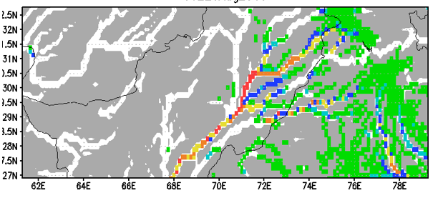
Flood Detection/Intensity (Depth above Threshold [mm])
20 August 2013
06 GMT
FLOOD IDENTIFICATION uses the calculated water depth (mm) relative to a Reference Level at each grid (1/8th degree)
REFERENCE LEVEL at each grid calculated from 15-year global hydrology model run using satellite rainfall data. Reference Level is 95th percentile of Routed Runoff (water depth) + δ
Routed Runoff (RR) > RR_{95th Percentile} + δ and Q (streamflow) > 10 m³/s,
where δ is temporal standard deviation of RR.

Slide 13
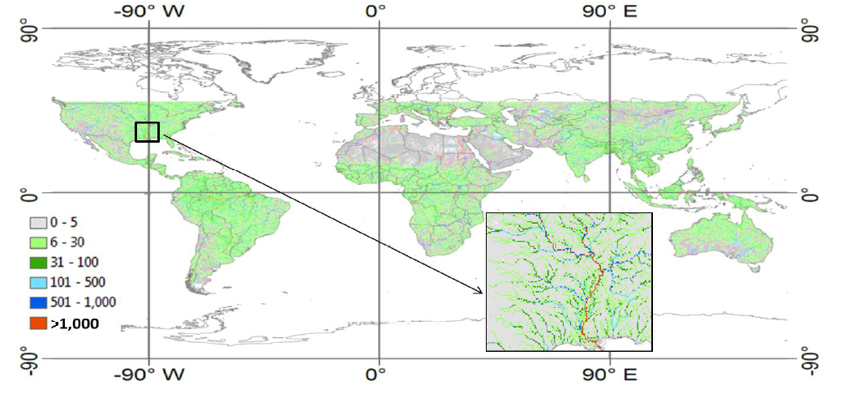
Flood Threshold Map
Routed Runoff (RR) > RR_{95th Percentile} + δ and Q (streamflow) > 10 m³/s,
where δ is temporal standard deviation of RR.

Slide 14
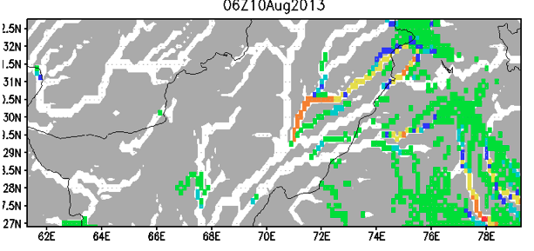
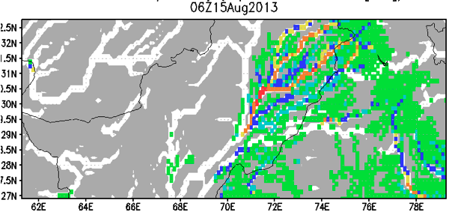
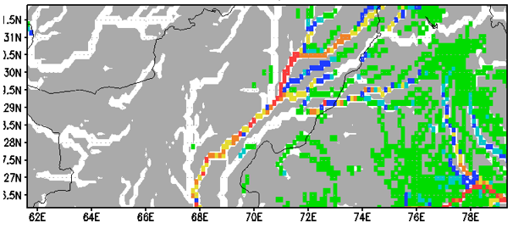
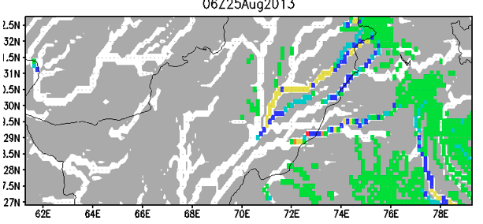
Flood Detection/Intensity (depth above threshold [mm])
10-25 August, 2013
10 August
15 August
20 August
25 August

Slide 15
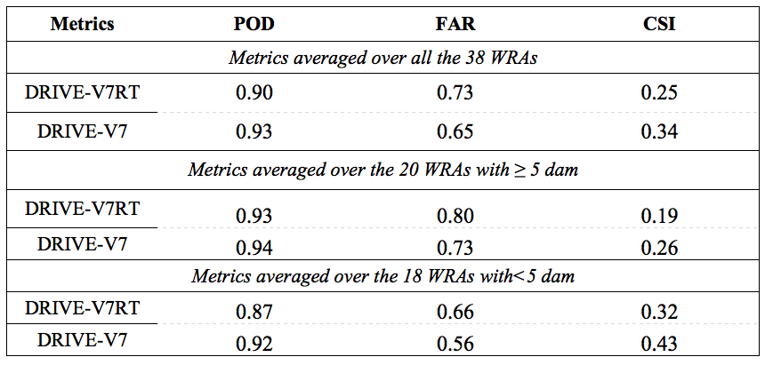
Flood detection verification against the Dartmouth Flood Observatory (DFO) flood database over the 38 Well Reported Areas (WRAs) for floods with duration more than 3 days.
Better flood detection statistics with “research” (instead of RT) rain, with fewer dams (drop in FAR) and for longer, larger floods
Bottom line--For 3-day floods in basins with few dams using RT rainfall:
POD ~ 0.9 FAR ~ 0.7

Slide 16
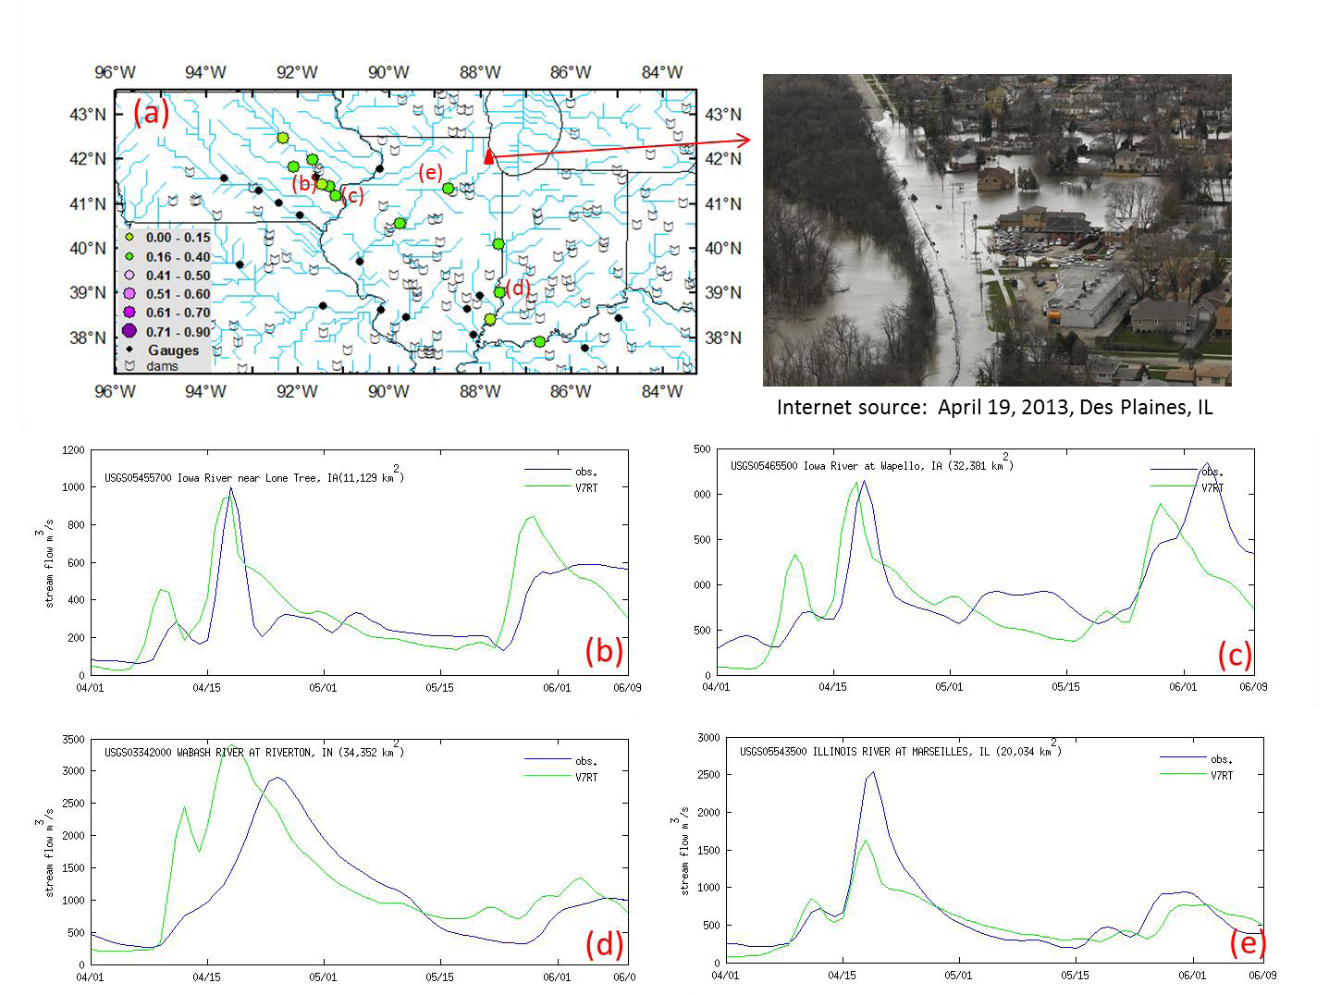
May 2013 over Midwest U.S.
Obs. Streamflow
Calculated
Iowa River
Iowa River
1 April
1 June
1 April
1 June
Wabash River
Illinois River
1 April
1 June
1 April
1 June

Slide 17
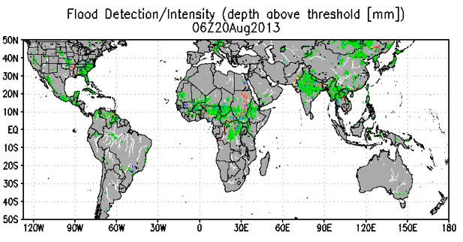
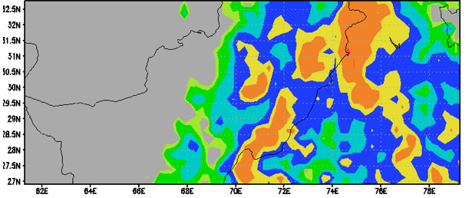
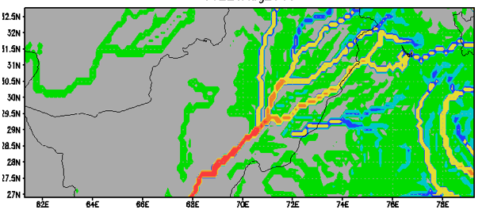
Global to Regional Flood Detection
Example: Detection of Recent Flooding in Pakistan
20 August 2013
06 GMT
Flood Detection/Intensity (Depth above Threshold [mm])
Flood Detection/Intensity (Depth above Threshold [mm])
X
Rainfall (7 day Accumulation [mm])
Streamflow [m³/s]
X
http://flood.umd.edu/

Slide 18
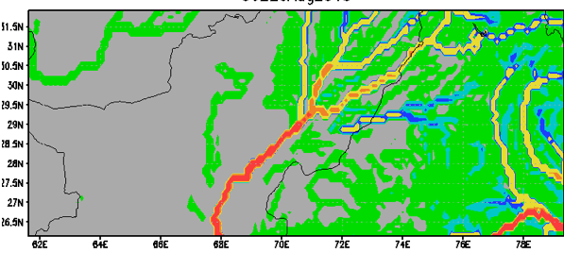
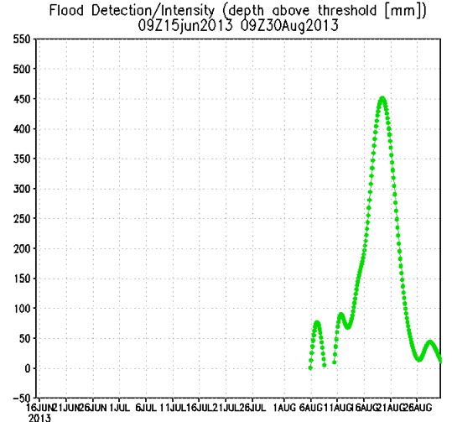
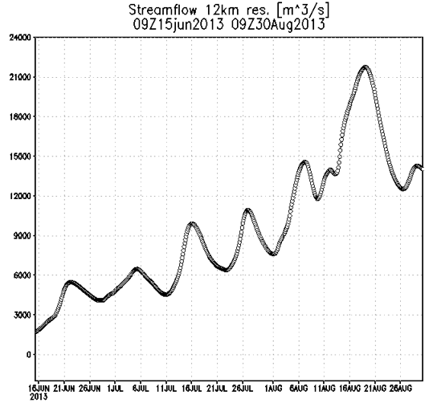
Recent Flooding in Indus River, Pakistan (20 August 2013)
Flood Detection/Intensity (depth above threshold [mm])
Streamflow (m³/s)
X
X
Flood Detection/Intensity (depth above threshold [mm])
12km Streamflow (m³/s)
1 July
1August
1 July
1August

Slide 19
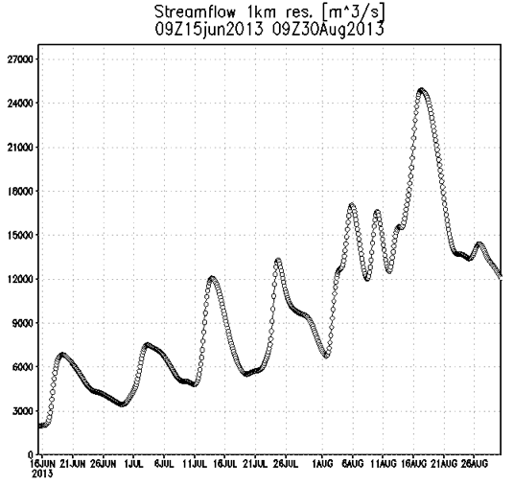
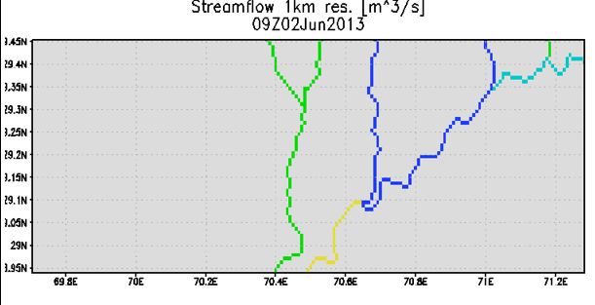
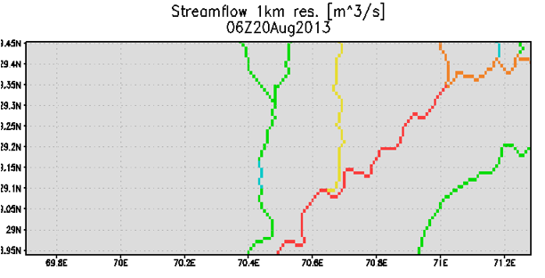
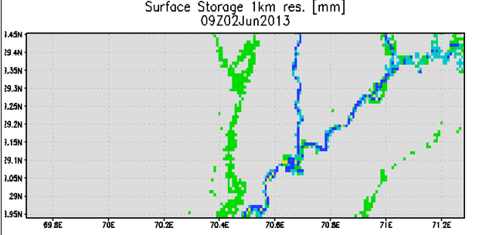
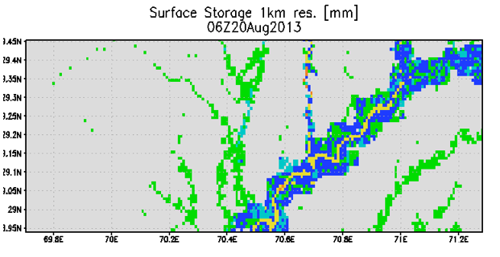
Real-time Calculations at 1 km
Streamflow (1 km) June-August
Streamflow and
Surface Storage (Routed Runoff + Bank Overflow)
June 2
August 20
Streamflow
Streamflow
X
X
June 2
August 20
Surface Storage
Surface Storage

Slide 20
Experimental Inundation Mapping at 1 km resolution
Colored grids are estimated as inundated
20 August 2013
Indus River Valley
Will be overlain with population and economic information for rapid estimates of disaster impacts and mitigation requirements

