Slide 1
The Science of Actionable Science
Remarks for the Global Precipitation Measurement Mission Workshop
NASA Applied Sciences Program, Earth Science Division
13 November 2013
Molly K. Macauley, Vice President for Research and Senior Fellow, RFF

Slide 2
Actionable science
Science for new knowledge (“K”) to maximize “delta K/ K” (Abdalati*)
Scientific networks are more connected
Disciplinary barriers are breaking down
Cyberinfrastructure and open access journals allow hyperlinks and faster access
Science on which to base action
Science and decision-making are better integrated
Much of the improvement is improving spatial/spectral/temporal resolution (and better characterization of uncertainty) in data/observations and models
Media and interested public are routinizing use of E.O. data and capacity to visualize quantitative data (Tufte)
Science on which to change a course of action
Data enabling projections and forecasts
Data enabling close to real-time adaptive management or identifying deviation in long-term trends
* Spring 2011 meetings of the NRC ASEB & SSB, 6 April

Slide 3
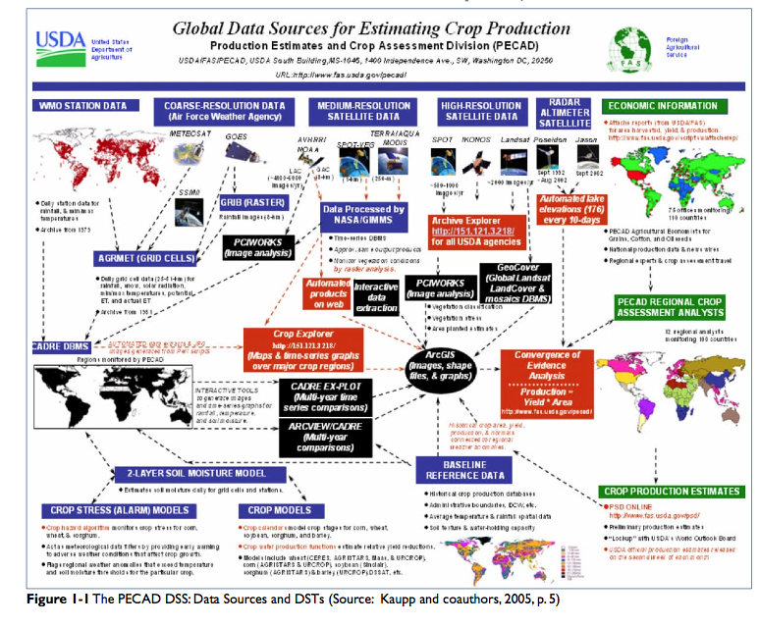

Slide 4
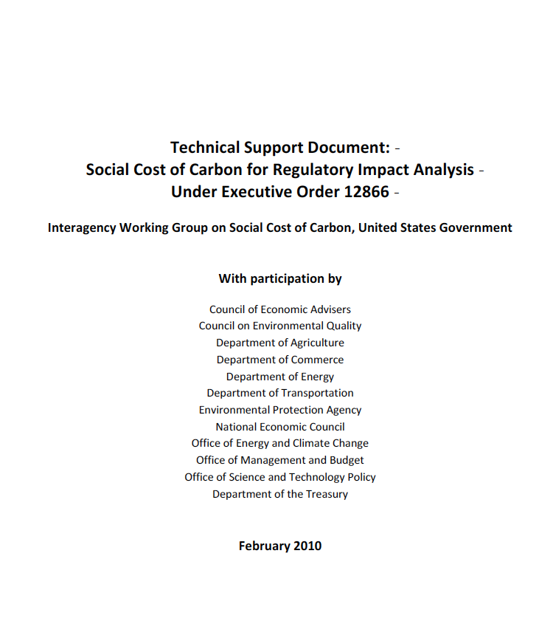
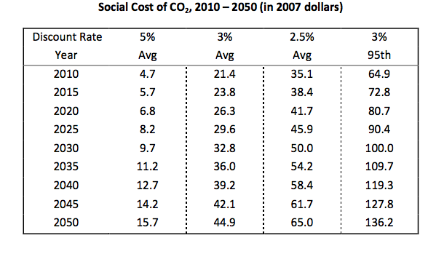
Atmospheric-Ocean General Circulation Models
(NOAA, NCAR, NASA, UK Met Office Hadley Centre, Max Planck Institute, CSIRO (Australia), Bjerknes Center (Norway), Institut Pierre Simon Laplace (France), Russian Academy of Sciences)
-- Climate data and their calibration
-- Models and model assumptions
--Computing power and computational algorithms
Integrated Assessment Models
(MERGE, MiniCAM, IGEM, EPPA, ADAGE, FUND, DICE, PAGE)
-- Climate, economic, demographic, technology data
-- Behavioral and technology assumptions
-- Other policy interactions

Slide 5
C cycle science, Earth observations and policy
Atmospheric-Ocean General Circulation Models
Integrated Assessment Models
Demographics, land variables/forest carbon poorly modeled and measured with global consistency; Earth system missing
Stabilization Goals
(parts/million or % reduction from baseline)
Policy Effectiveness
--Objectives met
--At what cost
-- Example: adjusting the “social cost of carbon” (US EPA)
Policy Elements and Economy’s Response
Example: Setting the “social cost of carbon” (US EPA)

Slide 6
Atmospheric-Ocean General Circulation Models
(NOAA, NCAR, NASA, UK Met Office Hadley Centre, Max Planck Institute, CSIRO (Australia), Bjerknes Center (Norway), Institut Pierre Simon Laplace (France), Russian Academy of Sciences)
-- Climate data and their calibration
-- Models and model assumptions
--Computing power and computational algorithms
Integrated Assessment Models
(MERGE, MiniCAM, IGEM, EPPA, ADAGE, FUND, DICE, PAGE)
-- Climate, economic, demographic, technology data
-- Behavioral and technology assumptions
-- Other policy interactions

Slide 7
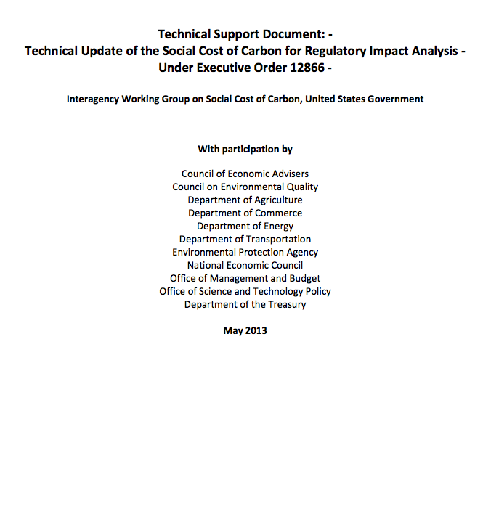
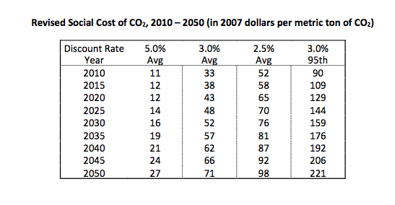
Revised due to new science

Slide 8
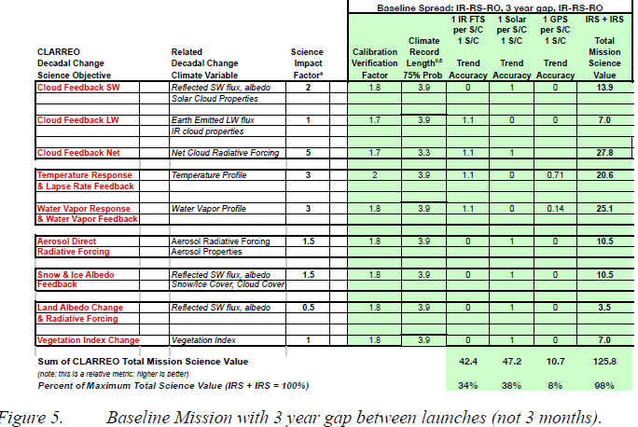
Science for new applied knowledge
IPCC
CLARREO Science Value Matrix, Wielecki et al

Slide 9
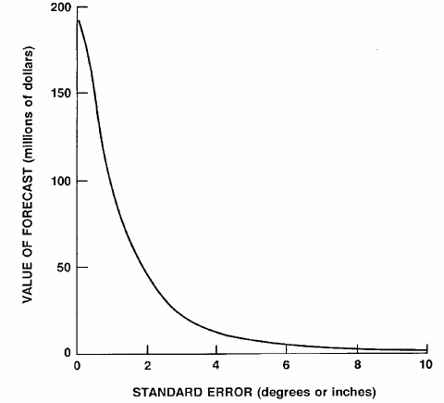
Parameters of the information matter
Agnew and Anderson 1977

Slide 10
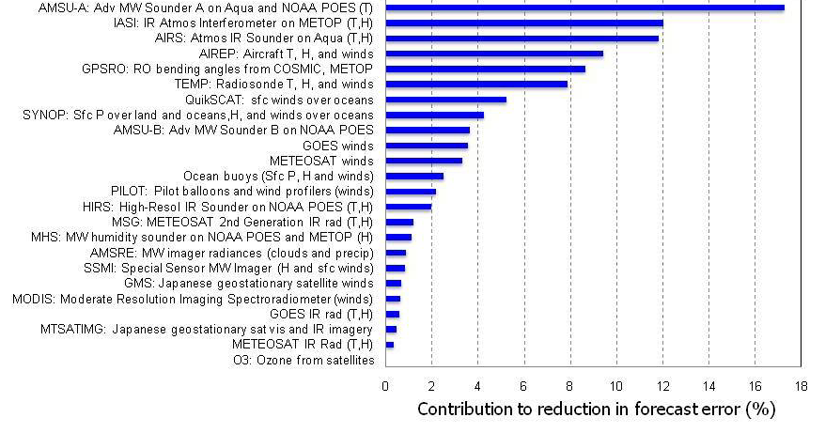
NRC, 2012, p. 17 -- courtesy of European Centre for Medium Range Weather Forecasts.

Slide 11
PRELIMINARY DO NOT QUOTE
VOI: BAU -> DICE Optimum @ 0.2C/decade
with 95% certainty: |  | mean damages [Trill USD 2015] | stdev
 | BAU 2.5% | 40.08 | 18.55
 | BAU 3% | 24.61 | 10.95
 | BAU 5% | 5.48 | 2.06
Discovered by EO | VOI-EO 2.5% | 8.32 | 4.19
 | VOI-EO 3% | 6.22 | 2.36
 | VOI-EO 5% | 2.56 | 0.43
Discovered by Alternative | VOI-A/C/I 2.5% | 10.74 | 4.74
 | VOI-A/C/I 3% | 7.88 | 2.51
 | VOI-A/C/I 5% | 3.06 | 0.37
Mean averted damages by switching with EO vs AltI [Trill USD 2015], BAU ->DICE Opt. 95% confidence, 0.2C/decade trigger
discount rate
2.5% | 2.43
3% | 1.66
5% | 0.50
Preliminary
Wielicki, Young, and Cooke DRAFT 2012

Slide 12
Value of Information (“VOI”)
Information has value if it can either make a current choice more secure and confident or if it can reveal a different choice as better than the current choice
Information may lead to recognition that there is more uncertainty than initially thought
Information has value even if it introduces more uncertainty (it reveals that what was thought to be certain may not be)
Perfect information may not be worth the cost of acquisition
Some attributes of information may confer more value than others (e.g., spatial, temporal, and spectral resolution; accuracy, precision, and other statistical properties of the distribution of information)
Information tends to have value if it enables an action or a decision not to take action
Information once acquired is available at low additional cost, and one person’s use may not preclude another person’s use. Some information is about goods and services for which we have no prices.

Slide 13
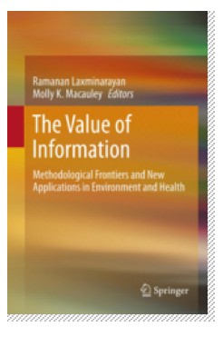
Incorporating VOI analyses: some methods and examples
Regulatory cost-effectiveness
Implementation of land use and air quality regulation (Bernknopf et al. 2012)
Monitoring water quality (Bouma, van der Woerd, et al. 2009)
Econometric modeling and estimation
Productivity (agriculture; Tenkorang and Lowenberg-DeBoer 2008)
Years of life expectancy (Obersteiner et al. 2012)
Other quality of life dimensions
Simulation modeling and estimation

Slide 14
Methods and examples, cont’d
Price- and cost-based derivation
Weather data for weather insurance (Osgood, 2012)
Drought and land use information for index insurance (Skees et al., 2007)
Losses averted from vector-borne disease (Hartley, 2012)
Probabilistic approaches
Bayesian belief networks (Cooke and Kousky, 2012)
Expert elicitation (probabilities of various tipping points, Interagency Working Group on Social Cost of Carbon, p. 32)

Slide 15
Using VOI to increase the benefit and value
Ascertain through the applied research effort:
what attributes are required (e.g., spatial, spectral, and temporal resolution, accuracy, precision, frequency, annotation, access)
Identify and reduce barriers to use
Identify and lower decisionmakers’ constraints
enhance actions that can be taken
increase the number of people who know about the information
demonstrate that information has value
Demonstrate that information is valued
Use the valuation exercise to think through data, research, partnerships, and assembly of results in a structured way
Feedback findings into mission design, next decadal survey, and ROSES- and other funding opportunities
Offer guidance for transferability of results and findings
Share findings more widely to audiences beyond the research team and partners

Slide 16
References
Bernknopf, R. 2012. “The Value of Earth Observations in Environmental Regulation: The Case of Land Use and Pollution,” in MK Macauley and R Laxminarayan (see below).
Bouma, J.A., H.J. van der Woerd, et al. 2009. “Assessing the Value of Information for Water Quality Management in the North Sea,” Journal of Environmental Management 90(2): 1280-1288.
Cooke, R. and C. Kousky. 2012. “Information and Catastrophe,” in MK Macauley and R Laxminarayan (see below).
Finkel, A.M. 2012. “Harvesting the Ripe Fruit: Why is it So Hard to be Well-Informed at the Moment of Decision?” in MK Macauley and R Laxminarayan (see below).
Hartley, D. F. 2012. “Space Imaging and Rift Valley Fever Vectors,” in MK Macauley and R Laxminarayan (see below).
Hirschleifer, J. and J.G. Riley. 1992. The Analytics of Uncertainty and Information (New York: Cambridge University Press).
Luce, R.D. and H. Raiffa. 1957. Games and Decisions: Introduction and Critical Survey (New York: Wiley & Sons).
Macauley, M.K. 1997. “Some Dimensions of the Value of Weather Information: General Principles and a Taxonomy of Empirical Approaches,” Workshop on the Social and Economic Impacts of Weather.
Macauley, M.K. 2006. “The Value of Information: Measuring the Contribution of Space-Derived Earth Science Data to Resource Management,” Space Policy 22(4): 274-282.
Macauley, M.K. and R. Laxminarayan. 2010.The Value of Information: Methodological Frontiers and New Applications for Realizing Social Benefit, Conference Summary (Washington, DC: Resources for the Future), August, at http://www.rff.org/Publications/Pages/PublicationDetails.aspx?PublicationID=21266
Macauley, M.K. and R. Laxminaryan. 2012. The Value of Information: Methodological Frontiers and New Applications for Realizing Social Benefit (Springer).

Slide 17
References, cont’d
National Research Council. 2001. Transforming Remote Sensing Data into Information and Applications (Washington, DC: National Academies Press).
Obersteiner, M., S. Fritz, I. McCallum, and F. Rydzak. 2012. “Valuing the Potential Impacts of GEOSS,” in MK Macauley and R Laxminarayan (see above).
Osgood, D. 2012. Earth Observations and Weather Index Insurance in MK Macauley and R Laxminarayan (see above).
Tenkorang, F. and J. Lowenberg-DeBoer. 2008. “On-Farm Profitability of Remote Sensing in Agriculture,” Journal of Terrestrial Observation 1(1): 50-59.
Wielecki, Bruce et al. 2012(?) CLARREO Science Value Matrix (presented at NRC Space Studies Board, Washington, DC).

Slide 18
Back Up Slides

Slide 19
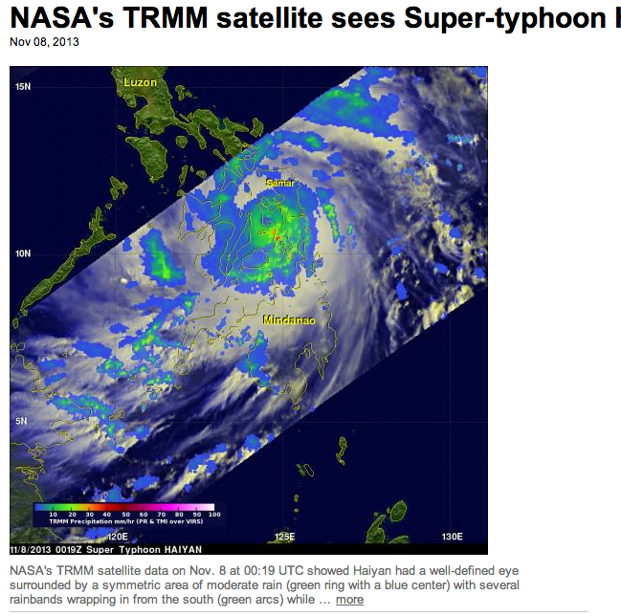
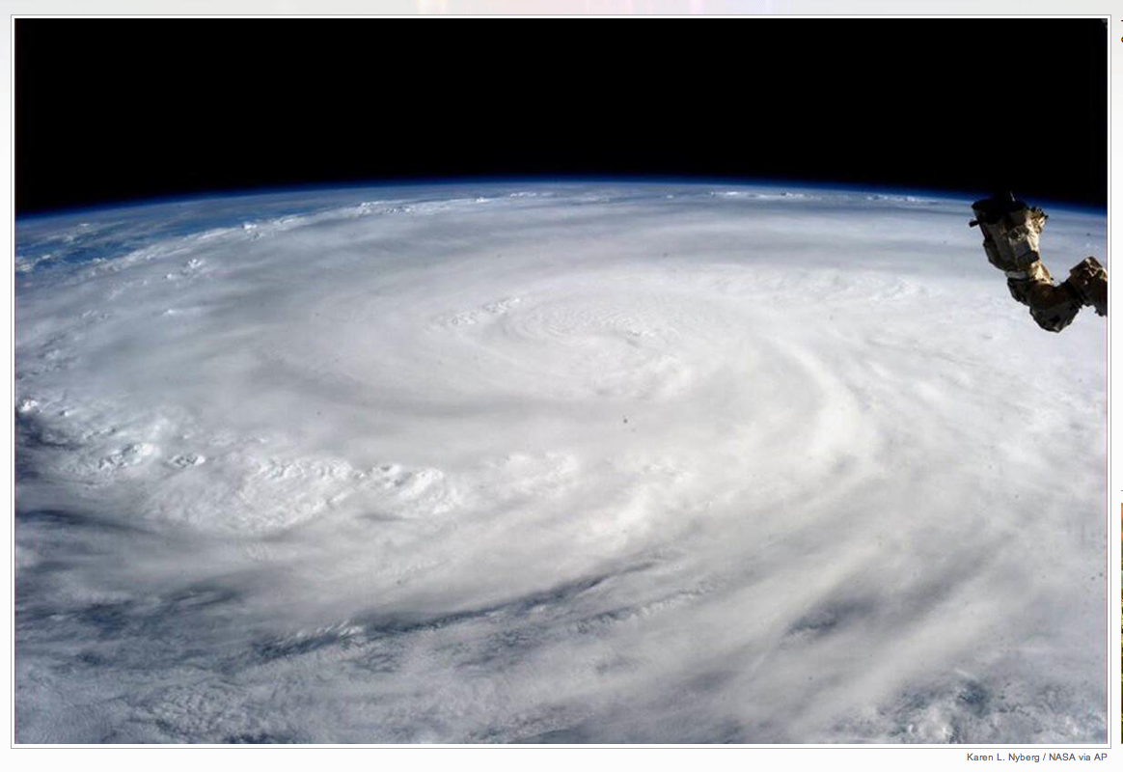
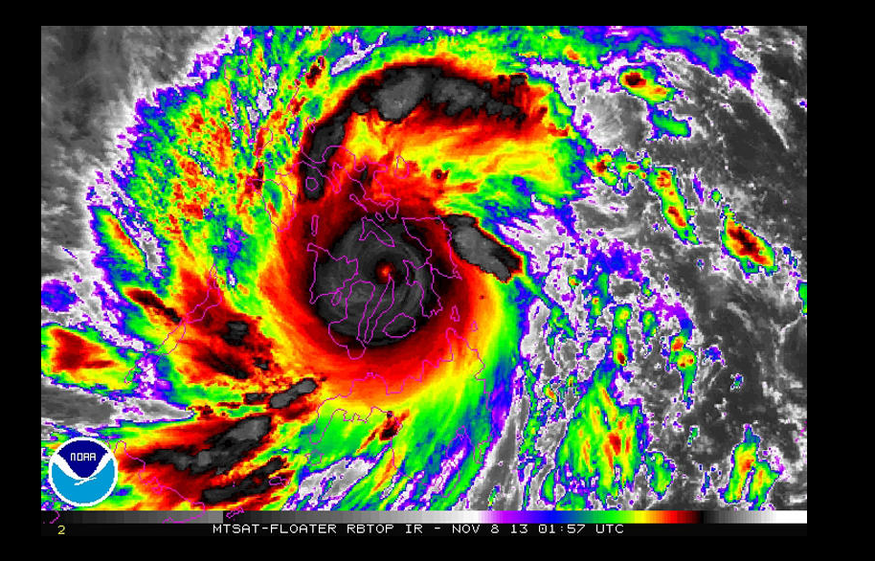

Slide 20
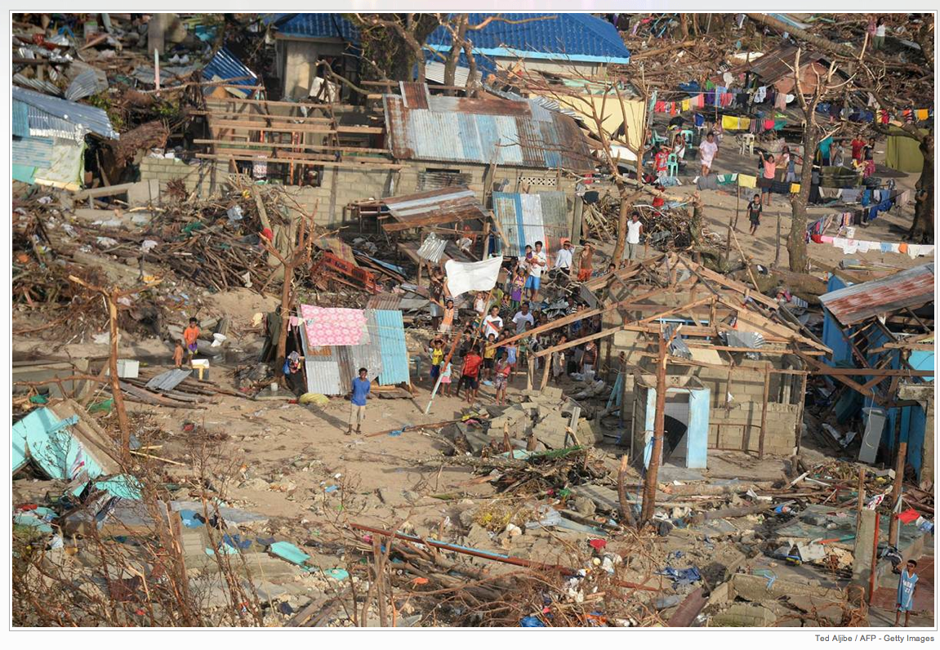
Victory Island, East Samar province, Nov 11 2013

